Slide 1
Hierarchical Clustering
CSCI 347
Adiesha Liyana Ralalage

Slide 2
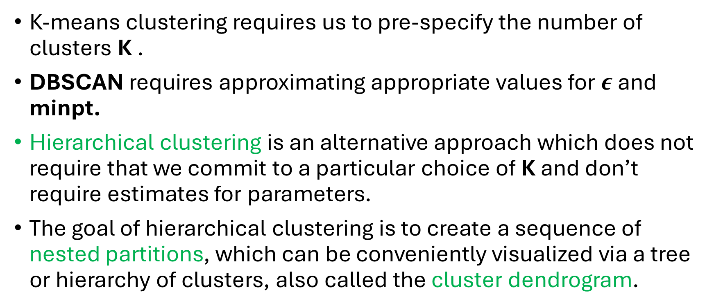
Hierarchical clustering
K-means clustering requires us to pre-specify the number of clusters K .
DBSCAN requires approximating appropriate values for $ε$ and minpt.
Hierarchical clustering is an alternative approach which does not require that we commit to a particular choice of K and don’t require estimates for parameters.
The goal of hierarchical clustering is to create a sequence of nested partitions, which can be conveniently visualized via a tree or hierarchy of clusters, also called the cluster dendrogram.

Slide 3
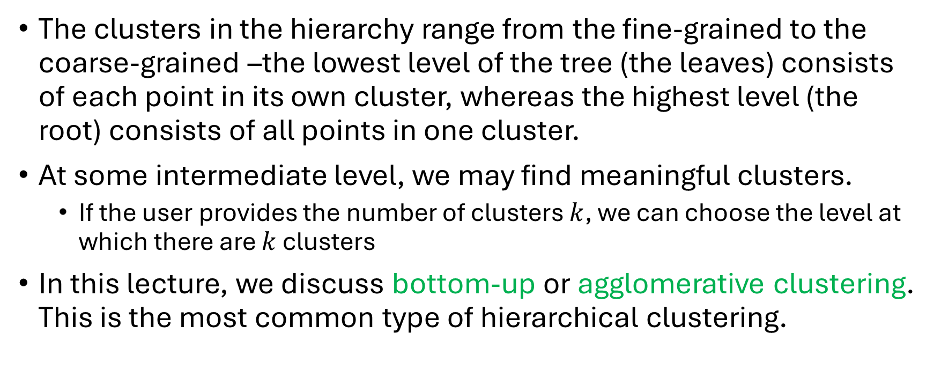
Hierarchical clustering
The clusters in the hierarchy range from the fine-grained to the coarse-grained –the lowest level of the tree (the leaves) consists of each point in its own cluster, whereas the highest level (the root) consists of all points in one cluster.
At some intermediate level, we may find meaningful clusters.
If the user provides the number of clusters $k$, we can choose the level at which there are $k$ clusters
In this lecture, we discuss bottom-up or agglomerative clustering. This is the most common type of hierarchical clustering.

Slide 4
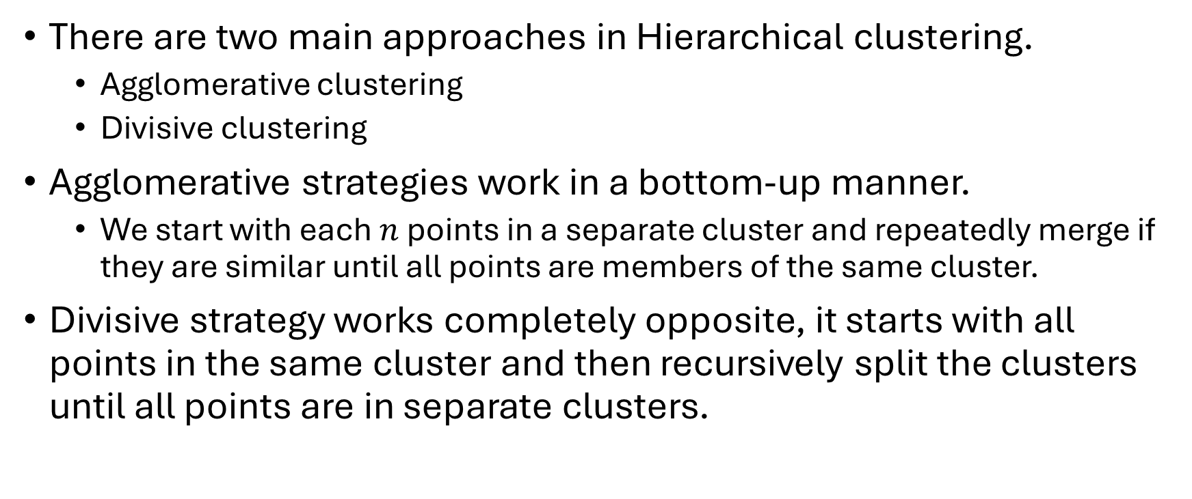
Hierarchical clustering
There are two main approaches in Hierarchical clustering.
Agglomerative clustering
Divisive clustering
Agglomerative strategies work in a bottom-up manner.
We start with each $n$ points in a separate cluster and repeatedly merge if they are similar until all points are members of the same cluster.
Divisive strategy works completely opposite, it starts with all points in the same cluster and then recursively split the clusters until all points are in separate clusters.
Notes:
collect or form into a mass or group.
"these small particles soon agglomerate together"

Slide 5
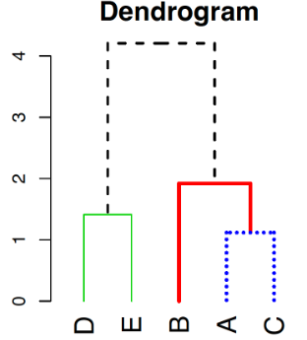
Hierarchical clustering algorithm
Higher level idea:
Start each point in its own cluster.
Identify closest two clusters and merge them.
Repeat.
Ends when all points are in a single cluster.
D
E
A
C
B

Slide 6
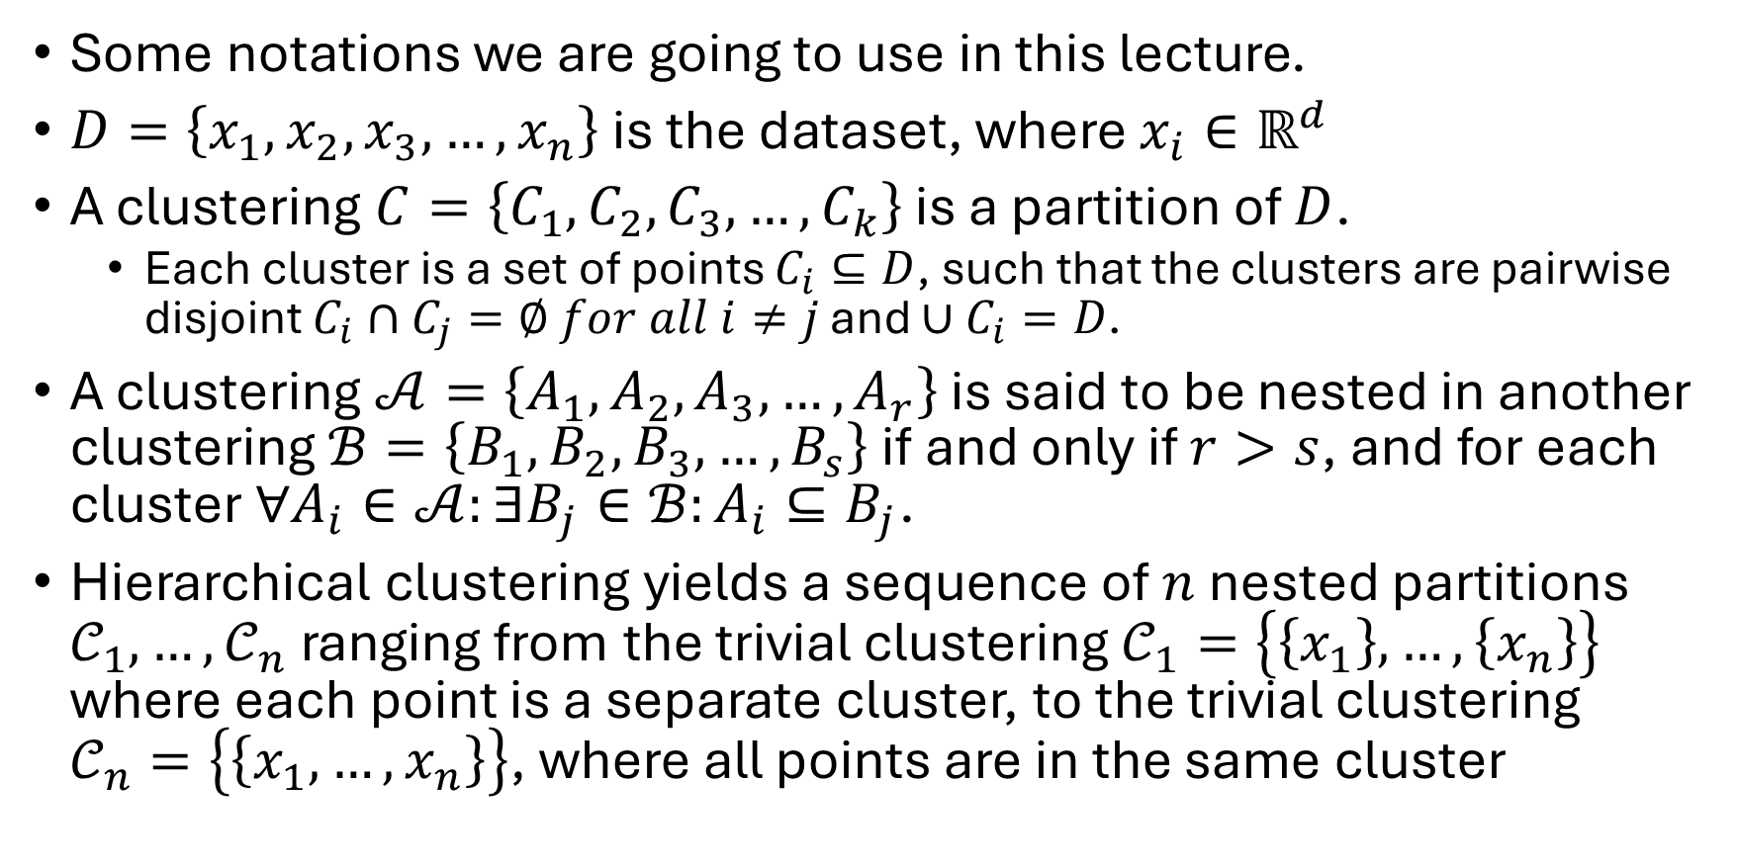
Hierarchical clustering algorithm
Some notations we are going to use in this lecture.
$D=\left\{x_{1},x_{2},x_{3}, …, x_{n}\right\}$ is the dataset, where $x_{i}∈ℝ^{d}$
A clustering $C=\left\{C_{1},C_{2},C_{3},…,C_{k}\right\}$ is a partition of $D$.
Each cluster is a set of points $C_{i}⊆D$, such that the clusters are pairwise disjoint $C_{i}∩C_{j}=∅ for all i≠j$ and $∪C_{i}=D$.
A clustering $𝒜=\left\{A_{1},A_{2},A_{3},…,A_{r}\right\}$ is said to be nested in another clustering $ℬ=\left\{B_{1},B_{2},B_{3},…,B_{s}\right\}$ if and only if $r>s$, and for each cluster $∀A_{i}∈𝒜:∃B_{j}∈ℬ:A_{i}⊆B_{j}$.
Hierarchical clustering yields a sequence of $n$ nested partitions $𝒞_{1},…,𝒞_{n}$ ranging from the trivial clustering$𝒞_{1}=\left\{\left\{x_{1}\right\},…,\left\{x_{n}\right\}\right\}$ where each point is a separate cluster, to the trivial clustering $𝒞_{n}=\left\{\left\{x_{1},…,x_{n}\right\}\right\}$, where all points are in the same cluster

Slide 7
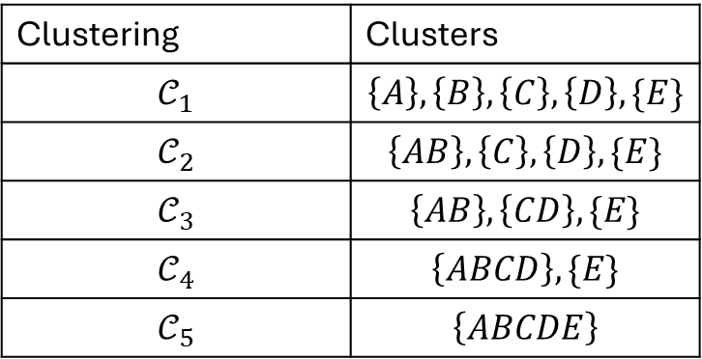
Hierarchical clustering algorithm
Cluster dendrogram is basically represents the hierarchy of clusters.
ABCDE
Clustering | Clusters
$$𝒞_{1}$$ | $$\left\{A\right\},\left\{B\right\},\left\{C\right\}, \left\{D\right\}, \{E\}$$
$$𝒞_{2}$$ | $$\left\{AB\right\},\left\{C\right\}, \left\{D\right\}, \{E\}$$
$$𝒞_{3}$$ | $$\left\{AB\right\},\left\{CD\right\}, \{E\}$$
$$𝒞_{4}$$ | $$\left\{ABCD\right\}, \{E\}$$
$$𝒞_{5}$$ | $$\left\{ABCDE\right\}$$
ABCD
E
D
C
A
AB
B
CD
A
B
C
D
E

Slide 8
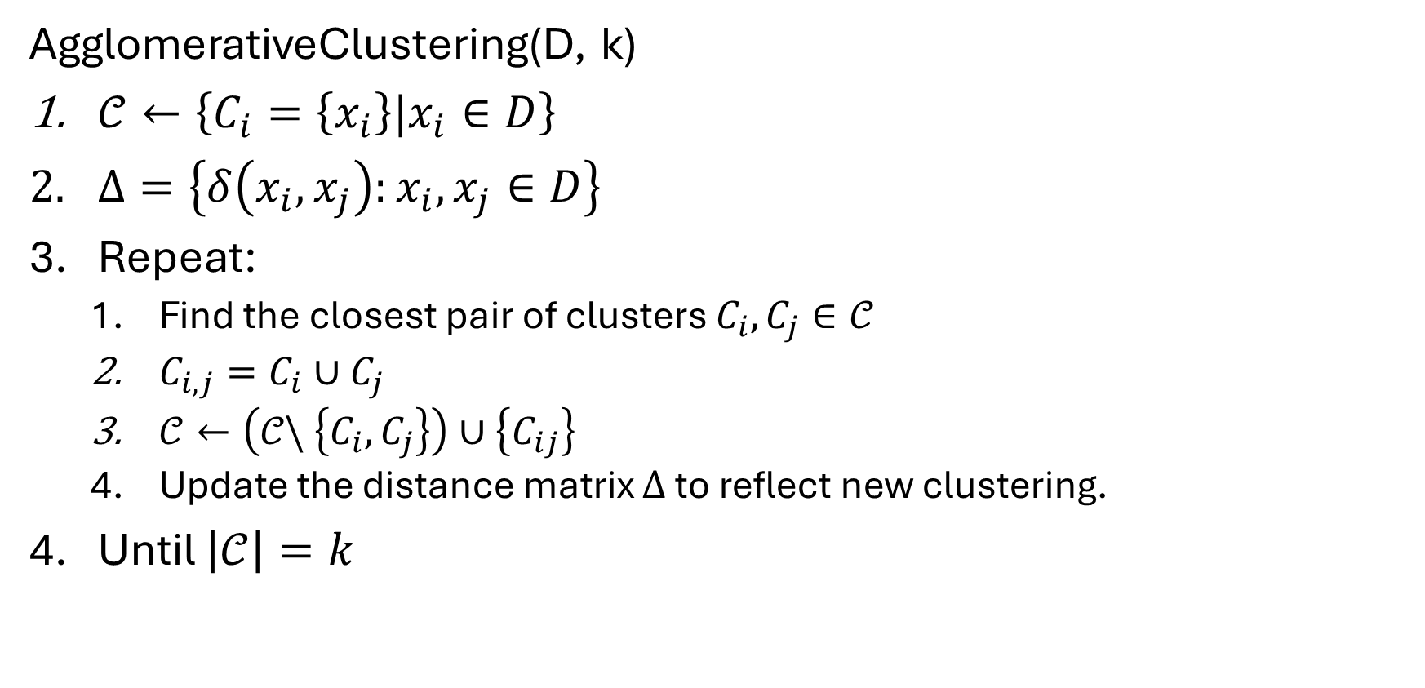
Agglomerative clustering algorithm
AgglomerativeClustering(D, k)
$𝒞←\left\{C_{i}=\left\{x_{i}\right\}|x_{i}∈D\right\}$
$Δ=\left\{δ\left(x_{i}, x_{j}\right):x_{i}, x_{j}∈D\right\}$
Repeat:
Find the closest pair of clusters $C_{i}, C_{j}∈𝒞$
$C_{i,j}=C_{i}∪C_{j}$
$𝒞←\left(𝒞\backslash \left\{C_{i},C_{j}\right\}\right)∪\left\{C_{ij}\right\}$
Update the distance matrix $Δ$ to reflect new clustering.
Until $\left|𝒞\right|=k$

Slide 9
Agglomerative clustering algorithm
When it comes to computing distances between two clusters, we can employ several strategies.
Single Link
Complete Link
Group average
Mean distance

Slide 10
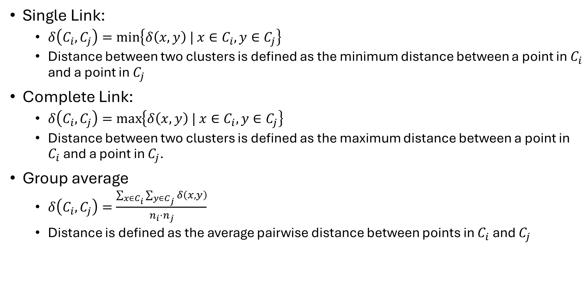
How to calculate the distance between clusters?
Single Link:
$δ\left(C_{i}, C_{j}\right)=\min\left\{δ\left(x,y\right) | x∈C_{i}, y∈C_{j}\right\}$
Distance between two clusters is defined as the minimum distance between a point in $C_{i}$ and a point in $C_{j}$
Complete Link:
$δ\left(C_{i}, C_{j}\right)=\max\left\{δ\left(x, y\right) | x∈C_{i}, y∈C_{j}\right\}$
Distance between two clusters is defined as the maximum distance between a point in $C_{i}$ and a point in $C_{j}$.
Group average
$δ\left(C_{i},C_{j}\right)=\frac{\sum_{x∈C_{i}}{\sum_{y∈C_{j}}{δ\left(x,y\right)}}}{n_{i}⋅n_{j}}$
Distance is defined as the average pairwise distance between points in $C_{i}$ and $C_{j}$
Notes:
The name, single link, comes from the observation that if we choose the minimum distance between points in the two clusters and connect those points, then (typically) only a single link would exist between those clusters, since all other pairs of points would be farther away.
The name, complete link, conveys the fact that if we connect all pairs of points from the two clusters with distance at most δ(Ci , Cj ), then all possible pairs would be connected, i.e., we get a complete linkage.

Slide 11
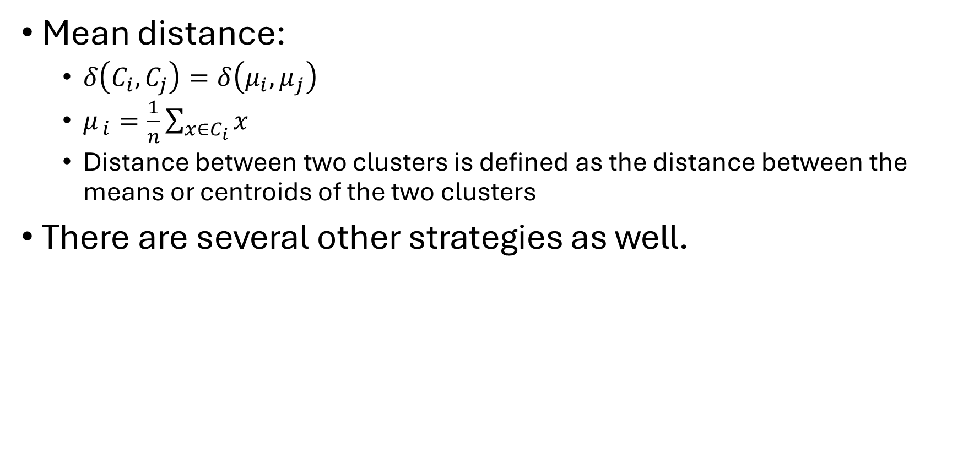
How to calculate the distance between clusters?
Mean distance:
$δ\left(C_{i}, C_{j}\right)=δ\left(μ_{i}, μ_{j}\right)$
$μ_{ i}=\frac{1}{n}\sum_{x∈C_{i}}{x}$
Distance between two clusters is defined as the distance between the means or centroids of the two clusters
There are several other strategies as well.
Notes:
The name, single link, comes from the observation that if we choose the minimum distance between points in the two clusters and connect those points, then (typically) only a single link would exist between those clusters, since all other pairs of points would be farther away.
The name, complete link, conveys the fact that if we connect all pairs of points from the two clusters with distance at most δ(Ci , Cj ), then all possible pairs would be connected, i.e., we get a complete linkage.

Slide 12
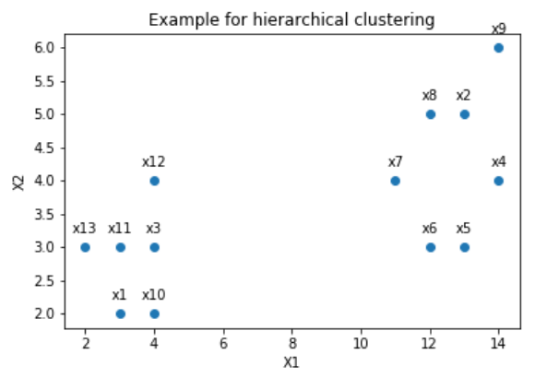
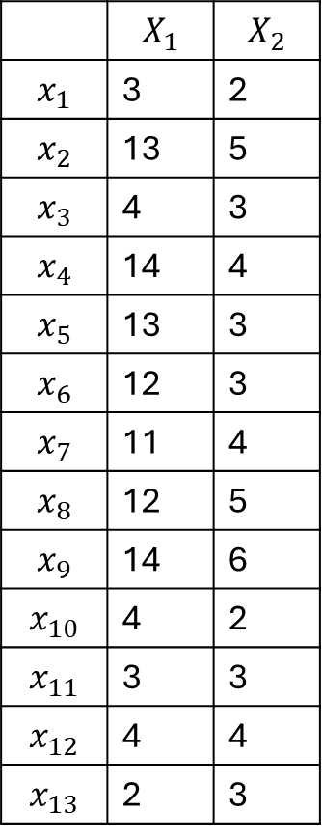
Example
 | $$X_{1}$$ | $$X_{2}$$
$$x_{1}$$ | 3 | 2
$$x_{2}$$ | 13 | 5
$$x_{3}$$ | 4 | 3
$$x_{4}$$ | 14 | 4
$$x_{5}$$ | 13 | 3
$$x_{6}$$ | 12 | 3
$$x_{7}$$ | 11 | 4
$$x_{8}$$ | 12 | 5
$$x_{9}$$ | 14 | 6
$$x_{10}$$ | 4 | 2
$$x_{11}$$ | 3 | 3
$$x_{12}$$ | 4 | 4
$$x_{13}$$ | 2 | 3

Slide 13
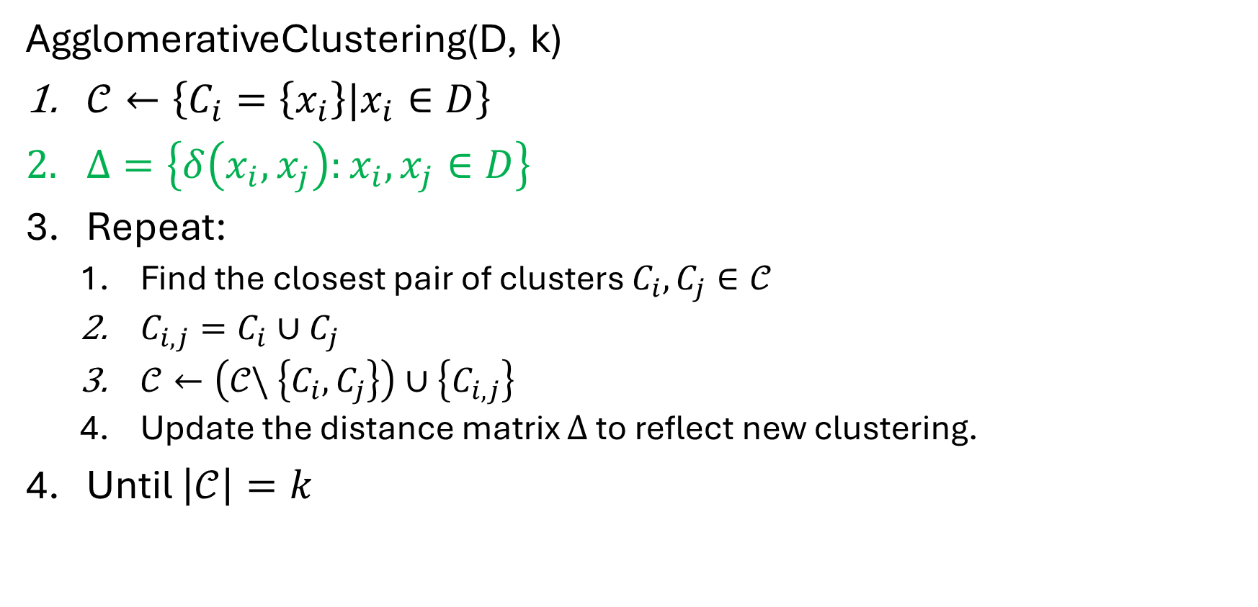
Agglomerative clustering algorithm
AgglomerativeClustering(D, k)
$𝒞←\left\{C_{i}=\left\{x_{i}\right\}|x_{i}∈D\right\}$
$Δ=\left\{δ\left(x_{i}, x_{j}\right):x_{i}, x_{j}∈D\right\}$
Repeat:
Find the closest pair of clusters $C_{i}, C_{j}∈𝒞$
$C_{i,j}=C_{i}∪C_{j}$
$𝒞←\left(𝒞\backslash \left\{C_{i},C_{j}\right\}\right)∪\left\{C_{i,j}\right\}$
Update the distance matrix $Δ$ to reflect new clustering.
Until $\left|𝒞\right|=k$

Slide 14
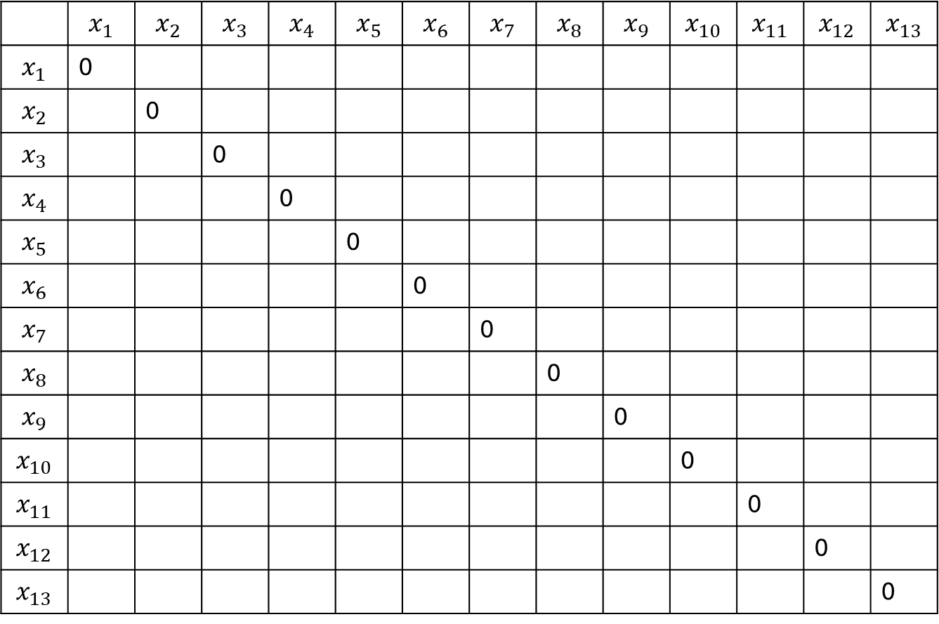
Example
 | $$x_{1}$$ | $$x_{2}$$ | $$x_{3}$$ | $$x_{4}$$ | $$x_{5}$$ | $$x_{6}$$ | $$x_{7}$$ | $$x_{8}$$ | $$x_{9}$$ | $$x_{10}$$ | $$x_{11}$$ | $$x_{12}$$ | $$x_{13}$$
$$x_{1}$$ | 0
$$x_{2}$$ |  | 0
$$x_{3}$$ |  |  | 0
$$x_{4}$$ |  |  |  | 0
$$x_{5}$$ |  |  |  |  | 0
$$x_{6}$$ |  |  |  |  |  | 0
$$x_{7}$$ |  |  |  |  |  |  | 0
$$x_{8}$$ |  |  |  |  |  |  |  | 0
$$x_{9}$$ |  |  |  |  |  |  |  |  | 0
$$x_{10}$$ |  |  |  |  |  |  |  |  |  | 0
$$x_{11}$$ |  |  |  |  |  |  |  |  |  |  | 0
$$x_{12}$$ |  |  |  |  |  |  |  |  |  |  |  | 0
$$x_{13}$$ |  |  |  |  |  |  |  |  |  |  |  |  | 0
 | $$X_{1}$$ | $$X_{2}$$
$$x_{1}$$ | 3 | 2
$$x_{2}$$ | 13 | 5
$$x_{3}$$ | 4 | 3
$$x_{4}$$ | 14 | 4
$$x_{5}$$ | 13 | 3
$$x_{6}$$ | 12 | 3
$$x_{7}$$ | 11 | 4
$$x_{8}$$ | 12 | 5
$$x_{9}$$ | 14 | 6
$$x_{10}$$ | 4 | 2
$$x_{11}$$ | 3 | 3
$$x_{12}$$ | 4 | 4
$$x_{13}$$ | 2 | 3

Slide 15
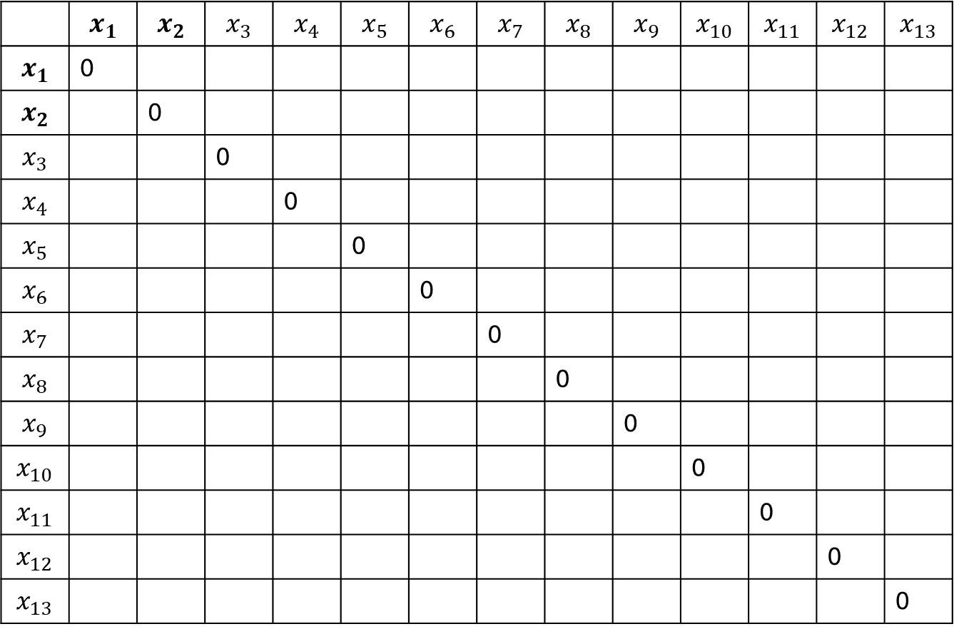
Example
 | $$x_{1}$$ | $$x_{2}$$ | $$x_{3}$$ | $$x_{4}$$ | $$x_{5}$$ | $$x_{6}$$ | $$x_{7}$$ | $$x_{8}$$ | $$x_{9}$$ | $$x_{10}$$ | $$x_{11}$$ | $$x_{12}$$ | $$x_{13}$$
$$x_{1}$$ | 0
$$x_{2}$$ |  | 0
$$x_{3}$$ |  |  | 0
$$x_{4}$$ |  |  |  | 0
$$x_{5}$$ |  |  |  |  | 0
$$x_{6}$$ |  |  |  |  |  | 0
$$x_{7}$$ |  |  |  |  |  |  | 0
$$x_{8}$$ |  |  |  |  |  |  |  | 0
$$x_{9}$$ |  |  |  |  |  |  |  |  | 0
$$x_{10}$$ |  |  |  |  |  |  |  |  |  | 0
$$x_{11}$$ |  |  |  |  |  |  |  |  |  |  | 0
$$x_{12}$$ |  |  |  |  |  |  |  |  |  |  |  | 0
$$x_{13}$$ |  |  |  |  |  |  |  |  |  |  |  |  | 0
 | $$X_{1}$$ | $$X_{2}$$
$$x_{1}$$ | 3 | 2
$$x_{2}$$ | 13 | 5
$$x_{3}$$ | 4 | 3
$$x_{4}$$ | 14 | 4
$$x_{5}$$ | 13 | 3
$$x_{6}$$ | 12 | 3
$$x_{7}$$ | 11 | 4
$$x_{8}$$ | 12 | 5
$$x_{9}$$ | 14 | 6
$$x_{10}$$ | 4 | 2
$$x_{11}$$ | 3 | 3
$$x_{12}$$ | 4 | 4
$$x_{13}$$ | 2 | 3

Slide 16
Example
 | $$x_{1}$$ | $$x_{2}$$ | $$x_{3}$$ | $$x_{4}$$ | $$x_{5}$$ | $$x_{6}$$ | $$x_{7}$$ | $$x_{8}$$ | $$x_{9}$$ | $$x_{10}$$ | $$x_{11}$$ | $$x_{12}$$ | $$x_{13}$$
$$x_{1}$$ | 0
$$x_{2}$$ |  | 0
$$x_{3}$$ |  |  | 0
$$x_{4}$$ |  |  |  | 0
$$x_{5}$$ |  |  |  |  | 0
$$x_{6}$$ |  |  |  |  |  | 0
$$x_{7}$$ |  |  |  |  |  |  | 0
$$x_{8}$$ |  |  |  |  |  |  |  | 0
$$x_{9}$$ |  |  |  |  |  |  |  |  | 0
$$x_{10}$$ |  |  |  |  |  |  |  |  |  | 0
$$x_{11}$$ |  |  |  |  |  |  |  |  |  |  | 0
$$x_{12}$$ |  |  |  |  |  |  |  |  |  |  |  | 0
$$x_{13}$$ |  |  |  |  |  |  |  |  |  |  |  |  | 0
 | $$X_{1}$$ | $$X_{2}$$
$$x_{1}$$ | 3 | 2
$$x_{2}$$ | 13 | 5
$$x_{3}$$ | 4 | 3
$$x_{4}$$ | 14 | 4
$$x_{5}$$ | 13 | 3
$$x_{6}$$ | 12 | 3
$$x_{7}$$ | 11 | 4
$$x_{8}$$ | 12 | 5
$$x_{9}$$ | 14 | 6
$$x_{10}$$ | 4 | 2
$$x_{11}$$ | 3 | 3
$$x_{12}$$ | 4 | 4
$$x_{13}$$ | 2 | 3
$$δ\left(x_{1},x_{2}\right)=\sqrt{{\left(3−13\right)}^{2}+{\left(2−5\right)}^{2}}=\sqrt{109}=10.44$$

Slide 17
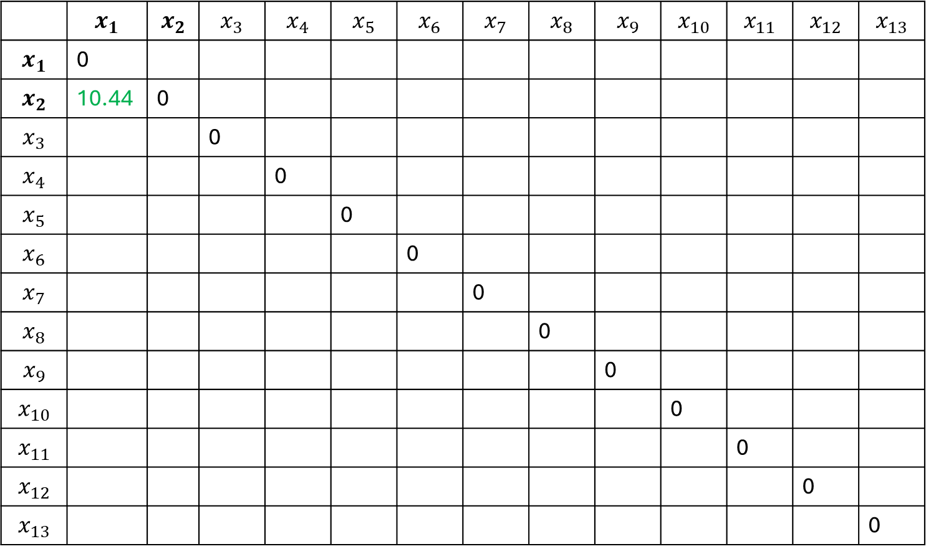
Example
 | $$x_{1}$$ | $$x_{2}$$ | $$x_{3}$$ | $$x_{4}$$ | $$x_{5}$$ | $$x_{6}$$ | $$x_{7}$$ | $$x_{8}$$ | $$x_{9}$$ | $$x_{10}$$ | $$x_{11}$$ | $$x_{12}$$ | $$x_{13}$$
$$x_{1}$$ | 0
$$x_{2}$$ | 10.44 | 0
$$x_{3}$$ |  |  | 0
$$x_{4}$$ |  |  |  | 0
$$x_{5}$$ |  |  |  |  | 0
$$x_{6}$$ |  |  |  |  |  | 0
$$x_{7}$$ |  |  |  |  |  |  | 0
$$x_{8}$$ |  |  |  |  |  |  |  | 0
$$x_{9}$$ |  |  |  |  |  |  |  |  | 0
$$x_{10}$$ |  |  |  |  |  |  |  |  |  | 0
$$x_{11}$$ |  |  |  |  |  |  |  |  |  |  | 0
$$x_{12}$$ |  |  |  |  |  |  |  |  |  |  |  | 0
$$x_{13}$$ |  |  |  |  |  |  |  |  |  |  |  |  | 0
 | $$X_{1}$$ | $$X_{2}$$
$$x_{1}$$ | 3 | 2
$$x_{2}$$ | 13 | 5
$$x_{3}$$ | 4 | 3
$$x_{4}$$ | 14 | 4
$$x_{5}$$ | 13 | 3
$$x_{6}$$ | 12 | 3
$$x_{7}$$ | 11 | 4
$$x_{8}$$ | 12 | 5
$$x_{9}$$ | 14 | 6
$$x_{10}$$ | 4 | 2
$$x_{11}$$ | 3 | 3
$$x_{12}$$ | 4 | 4
$$x_{13}$$ | 2 | 3
$$δ\left(x_{1},x_{2}\right)=\sqrt{{\left(3−13\right)}^{2}+{\left(2−5\right)}^{2}}=\sqrt{109}=10.44$$

Slide 18
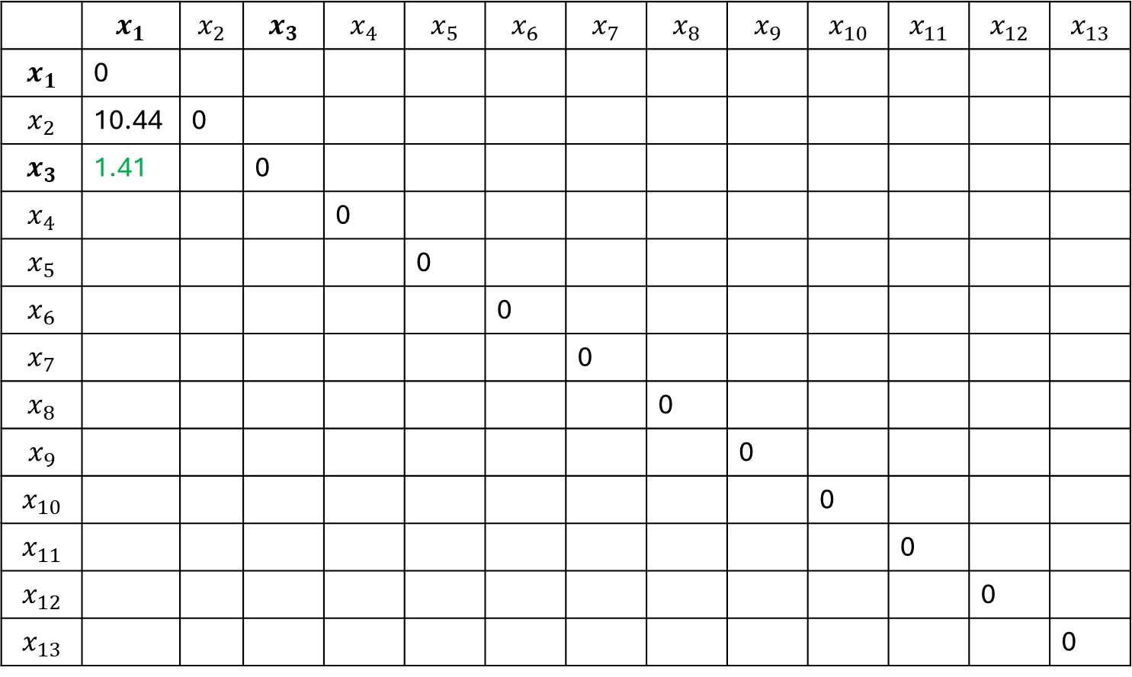
Example
 | $$x_{1}$$ | $$x_{2}$$ | $$x_{3}$$ | $$x_{4}$$ | $$x_{5}$$ | $$x_{6}$$ | $$x_{7}$$ | $$x_{8}$$ | $$x_{9}$$ | $$x_{10}$$ | $$x_{11}$$ | $$x_{12}$$ | $$x_{13}$$
$$x_{1}$$ | 0
$$x_{2}$$ | 10.44 | 0
$$x_{3}$$ | 1.41 |  | 0
$$x_{4}$$ |  |  |  | 0
$$x_{5}$$ |  |  |  |  | 0
$$x_{6}$$ |  |  |  |  |  | 0
$$x_{7}$$ |  |  |  |  |  |  | 0
$$x_{8}$$ |  |  |  |  |  |  |  | 0
$$x_{9}$$ |  |  |  |  |  |  |  |  | 0
$$x_{10}$$ |  |  |  |  |  |  |  |  |  | 0
$$x_{11}$$ |  |  |  |  |  |  |  |  |  |  | 0
$$x_{12}$$ |  |  |  |  |  |  |  |  |  |  |  | 0
$$x_{13}$$ |  |  |  |  |  |  |  |  |  |  |  |  | 0
 | $$X_{1}$$ | $$X_{2}$$
$$x_{1}$$ | 3 | 2
$$x_{2}$$ | 13 | 5
$$x_{3}$$ | 4 | 3
$$x_{4}$$ | 14 | 4
$$x_{5}$$ | 13 | 3
$$x_{6}$$ | 12 | 3
$$x_{7}$$ | 11 | 4
$$x_{8}$$ | 12 | 5
$$x_{9}$$ | 14 | 6
$$x_{10}$$ | 4 | 2
$$x_{11}$$ | 3 | 3
$$x_{12}$$ | 4 | 4
$$x_{13}$$ | 2 | 3
$$δ\left(x_{1},x_{3}\right)=\sqrt{{\left(3−4\right)}^{2}+{\left(2−3\right)}^{2}}=\sqrt{2}=1.41$$

Slide 19
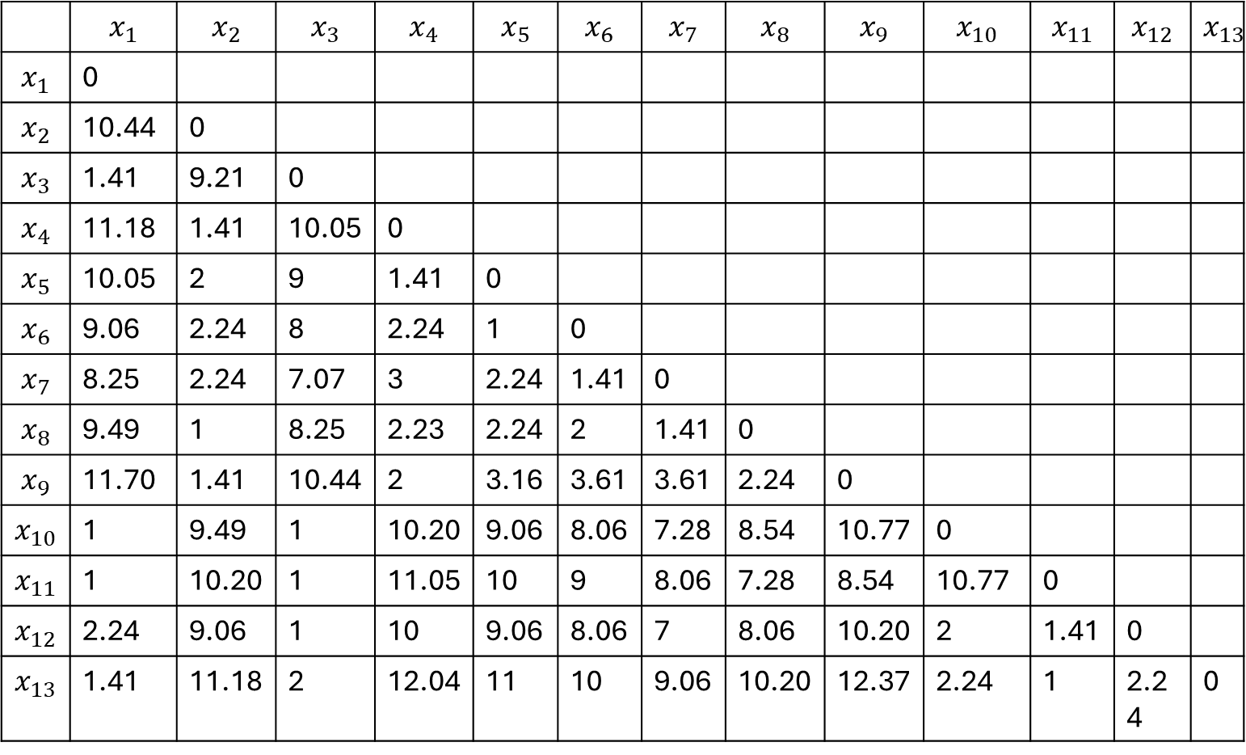
Example
 | $$X_{1}$$ | $$X_{2}$$
$$x_{1}$$ | 3 | 2
$$x_{2}$$ | 13 | 5
$$x_{3}$$ | 4 | 3
$$x_{4}$$ | 14 | 4
$$x_{5}$$ | 13 | 3
$$x_{6}$$ | 12 | 3
$$x_{7}$$ | 11 | 4
$$x_{8}$$ | 12 | 5
$$x_{9}$$ | 14 | 6
$$x_{10}$$ | 4 | 2
$$x_{11}$$ | 3 | 3
$$x_{12}$$ | 4 | 4
$$x_{13}$$ | 2 | 3
 | $$x_{1}$$ | $$x_{2}$$ | $$x_{3}$$ | $$x_{4}$$ | $$x_{5}$$ | $$x_{6}$$ | $$x_{7}$$ | $$x_{8}$$ | $$x_{9}$$ | $$x_{10}$$ | $$x_{11}$$ | $$x_{12}$$ | $$x_{13}$$
$$x_{1}$$ | 0
$$x_{2}$$ | 10.44 | 0
$$x_{3}$$ | 1.41 | 9.21 | 0
$$x_{4}$$ | 11.18 | 1.41 | 10.05 | 0
$$x_{5}$$ | 10.05 | 2 | 9 | 1.41 | 0
$$x_{6}$$ | 9.06 | 2.24 | 8 | 2.24 | 1 | 0
$$x_{7}$$ | 8.25 | 2.24 | 7.07 | 3 | 2.24 | 1.41 | 0
$$x_{8}$$ | 9.49 | 1 | 8.25 | 2.23 | 2.24 | 2 | 1.41 | 0
$$x_{9}$$ | 11.70 | 1.41 | 10.44 | 2 | 3.16 | 3.61 | 3.61 | 2.24 | 0
$$x_{10}$$ | 1 | 9.49 | 1 | 10.20 | 9.06 | 8.06 | 7.28 | 8.54 | 10.77 | 0
$$x_{11}$$ | 1 | 10.20 | 1 | 11.05 | 10 | 9 | 8.06 | 7.28 | 8.54 | 10.77 | 0
$$x_{12}$$ | 2.24 | 9.06 | 1 | 10 | 9.06 | 8.06 | 7 | 8.06 | 10.20 | 2 | 1.41 | 0
$$x_{13}$$ | 1.41 | 11.18 | 2 | 12.04 | 11 | 10 | 9.06 | 10.20 | 12.37 | 2.24 | 1 | 2.24 | 0

Slide 20
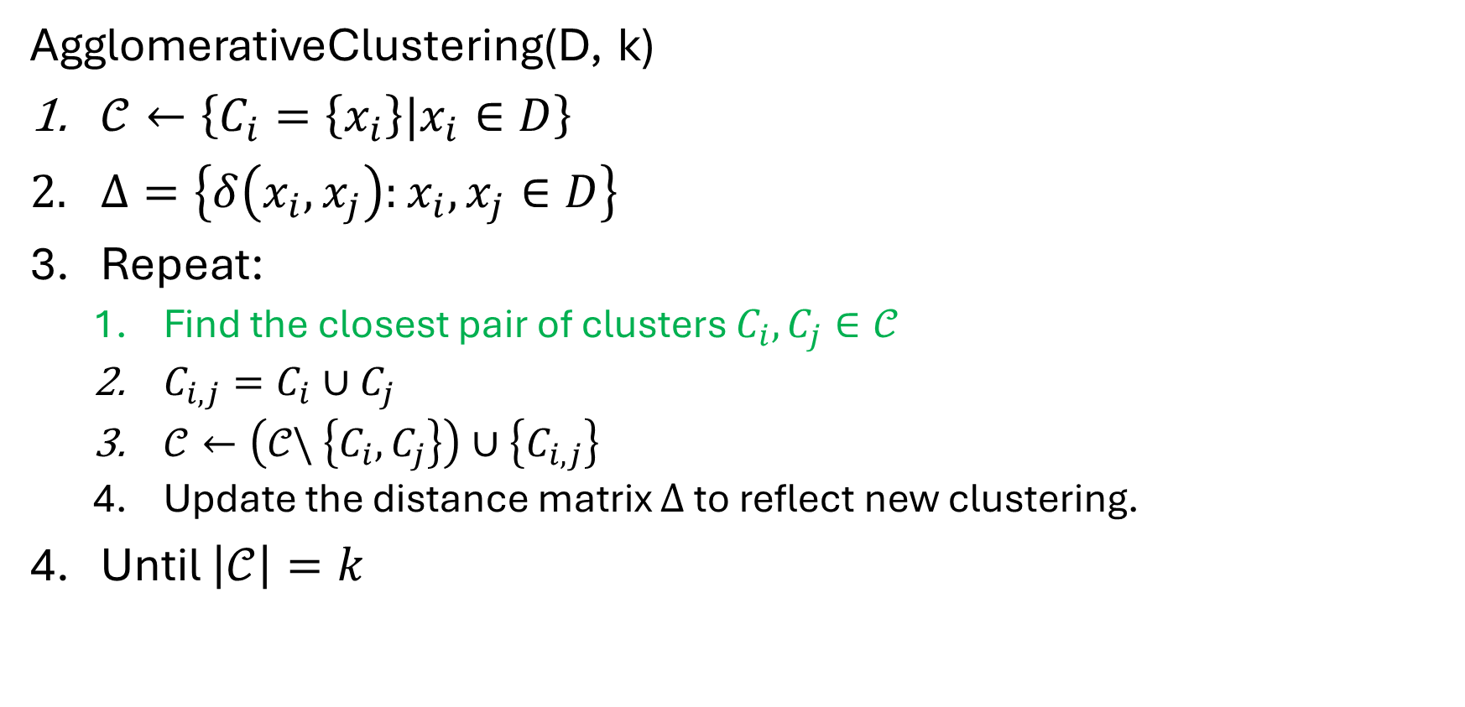
Agglomerative clustering algorithm
AgglomerativeClustering(D, k)
$𝒞←\left\{C_{i}=\left\{x_{i}\right\}|x_{i}∈D\right\}$
$Δ=\left\{δ\left(x_{i}, x_{j}\right):x_{i}, x_{j}∈D\right\}$
Repeat:
Find the closest pair of clusters $C_{i}, C_{j}∈𝒞$
$C_{i,j}=C_{i}∪C_{j}$
$𝒞←\left(𝒞\backslash \left\{C_{i},C_{j}\right\}\right)∪\left\{C_{i,j}\right\}$
Update the distance matrix $Δ$ to reflect new clustering.
Until $\left|𝒞\right|=k$

Slide 21
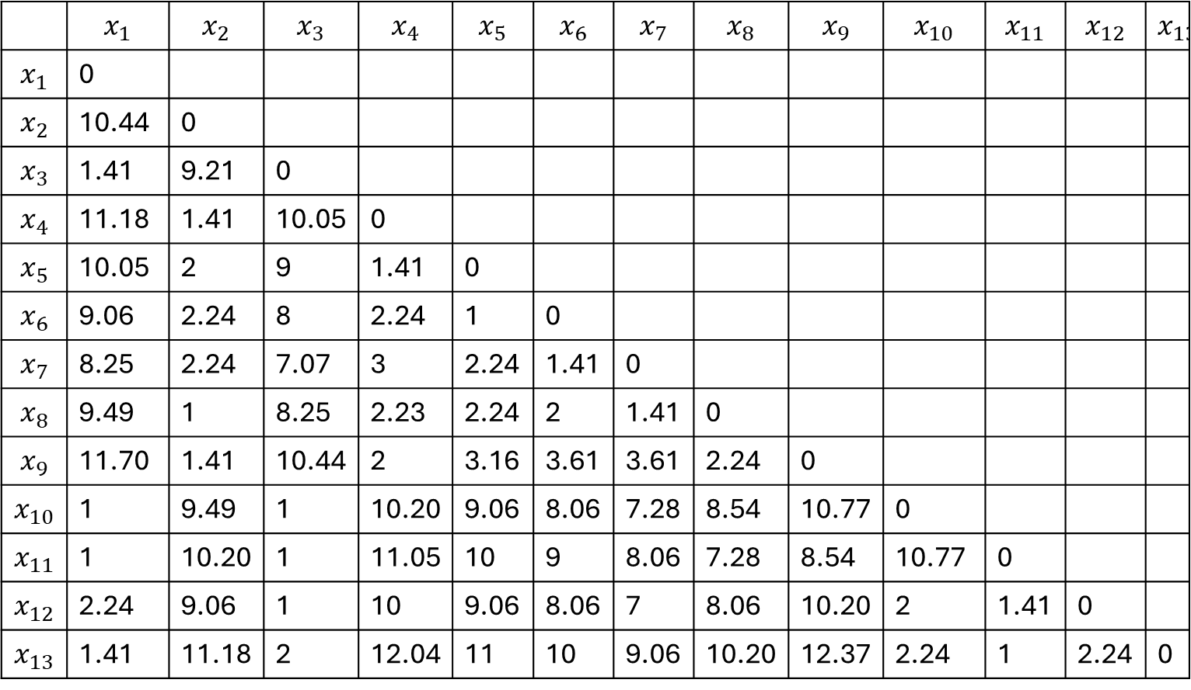
Example
 | $$X_{1}$$ | $$X_{2}$$
$$x_{1}$$ | 3 | 2
$$x_{2}$$ | 13 | 5
$$x_{3}$$ | 4 | 3
$$x_{4}$$ | 14 | 4
$$x_{5}$$ | 13 | 3
$$x_{6}$$ | 12 | 3
$$x_{7}$$ | 11 | 4
$$x_{8}$$ | 12 | 5
$$x_{9}$$ | 14 | 6
$$x_{10}$$ | 4 | 2
$$x_{11}$$ | 3 | 3
$$x_{12}$$ | 4 | 4
$$x_{13}$$ | 2 | 3
 | $$x_{1}$$ | $$x_{2}$$ | $$x_{3}$$ | $$x_{4}$$ | $$x_{5}$$ | $$x_{6}$$ | $$x_{7}$$ | $$x_{8}$$ | $$x_{9}$$ | $$x_{10}$$ | $$x_{11}$$ | $$x_{12}$$ | $$x_{13}$$
$$x_{1}$$ | 0
$$x_{2}$$ | 10.44 | 0
$$x_{3}$$ | 1.41 | 9.21 | 0
$$x_{4}$$ | 11.18 | 1.41 | 10.05 | 0
$$x_{5}$$ | 10.05 | 2 | 9 | 1.41 | 0
$$x_{6}$$ | 9.06 | 2.24 | 8 | 2.24 | 1 | 0
$$x_{7}$$ | 8.25 | 2.24 | 7.07 | 3 | 2.24 | 1.41 | 0
$$x_{8}$$ | 9.49 | 1 | 8.25 | 2.23 | 2.24 | 2 | 1.41 | 0
$$x_{9}$$ | 11.70 | 1.41 | 10.44 | 2 | 3.16 | 3.61 | 3.61 | 2.24 | 0
$$x_{10}$$ | 1 | 9.49 | 1 | 10.20 | 9.06 | 8.06 | 7.28 | 8.54 | 10.77 | 0
$$x_{11}$$ | 1 | 10.20 | 1 | 11.05 | 10 | 9 | 8.06 | 7.28 | 8.54 | 10.77 | 0
$$x_{12}$$ | 2.24 | 9.06 | 1 | 10 | 9.06 | 8.06 | 7 | 8.06 | 10.20 | 2 | 1.41 | 0
$$x_{13}$$ | 1.41 | 11.18 | 2 | 12.04 | 11 | 10 | 9.06 | 10.20 | 12.37 | 2.24 | 1 | 2.24 | 0

Slide 22
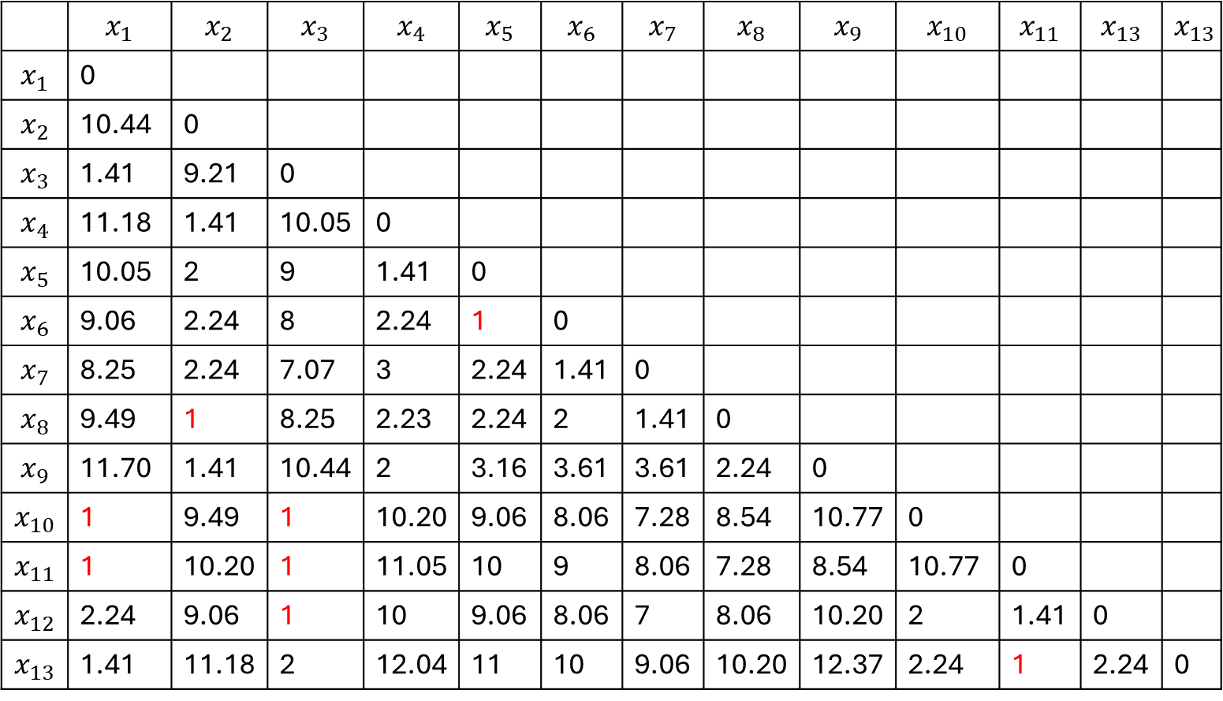
Example
 | $$X_{1}$$ | $$X_{2}$$
$$x_{1}$$ | 3 | 2
$$x_{2}$$ | 13 | 5
$$x_{3}$$ | 4 | 3
$$x_{4}$$ | 14 | 4
$$x_{5}$$ | 13 | 3
$$x_{6}$$ | 12 | 3
$$x_{7}$$ | 11 | 4
$$x_{8}$$ | 12 | 5
$$x_{9}$$ | 14 | 6
$$x_{10}$$ | 4 | 2
$$x_{11}$$ | 3 | 3
$$x_{12}$$ | 4 | 4
$$x_{13}$$ | 2 | 3
 | $$x_{1}$$ | $$x_{2}$$ | $$x_{3}$$ | $$x_{4}$$ | $$x_{5}$$ | $$x_{6}$$ | $$x_{7}$$ | $$x_{8}$$ | $$x_{9}$$ | $$x_{10}$$ | $$x_{11}$$ | $$x_{13}$$ | $$x_{13}$$
$$x_{1}$$ | 0
$$x_{2}$$ | 10.44 | 0
$$x_{3}$$ | 1.41 | 9.21 | 0
$$x_{4}$$ | 11.18 | 1.41 | 10.05 | 0
$$x_{5}$$ | 10.05 | 2 | 9 | 1.41 | 0
$$x_{6}$$ | 9.06 | 2.24 | 8 | 2.24 | 1 | 0
$$x_{7}$$ | 8.25 | 2.24 | 7.07 | 3 | 2.24 | 1.41 | 0
$$x_{8}$$ | 9.49 | 1 | 8.25 | 2.23 | 2.24 | 2 | 1.41 | 0
$$x_{9}$$ | 11.70 | 1.41 | 10.44 | 2 | 3.16 | 3.61 | 3.61 | 2.24 | 0
$$x_{10}$$ | 1 | 9.49 | 1 | 10.20 | 9.06 | 8.06 | 7.28 | 8.54 | 10.77 | 0
$$x_{11}$$ | 1 | 10.20 | 1 | 11.05 | 10 | 9 | 8.06 | 7.28 | 8.54 | 10.77 | 0
$$x_{12}$$ | 2.24 | 9.06 | 1 | 10 | 9.06 | 8.06 | 7 | 8.06 | 10.20 | 2 | 1.41 | 0
$$x_{13}$$ | 1.41 | 11.18 | 2 | 12.04 | 11 | 10 | 9.06 | 10.20 | 12.37 | 2.24 | 1 | 2.24 | 0

Slide 23
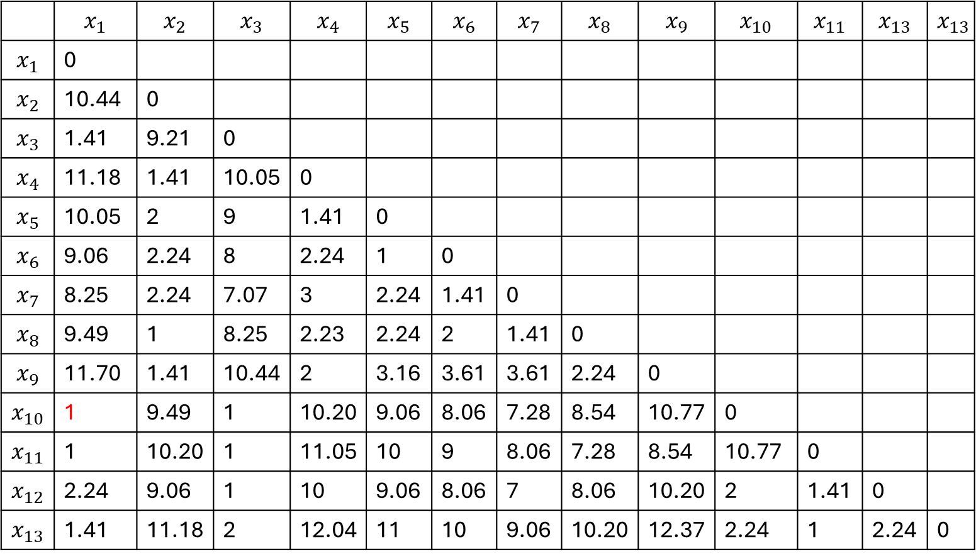
Example
 | $$X_{1}$$ | $$X_{2}$$
$$x_{1}$$ | 3 | 2
$$x_{2}$$ | 13 | 5
$$x_{3}$$ | 4 | 3
$$x_{4}$$ | 14 | 4
$$x_{5}$$ | 13 | 3
$$x_{6}$$ | 12 | 3
$$x_{7}$$ | 11 | 4
$$x_{8}$$ | 12 | 5
$$x_{9}$$ | 14 | 6
$$x_{10}$$ | 4 | 2
$$x_{11}$$ | 3 | 3
$$x_{12}$$ | 4 | 4
$$x_{13}$$ | 2 | 3
 | $$x_{1}$$ | $$x_{2}$$ | $$x_{3}$$ | $$x_{4}$$ | $$x_{5}$$ | $$x_{6}$$ | $$x_{7}$$ | $$x_{8}$$ | $$x_{9}$$ | $$x_{10}$$ | $$x_{11}$$ | $$x_{13}$$ | $$x_{13}$$
$$x_{1}$$ | 0
$$x_{2}$$ | 10.44 | 0
$$x_{3}$$ | 1.41 | 9.21 | 0
$$x_{4}$$ | 11.18 | 1.41 | 10.05 | 0
$$x_{5}$$ | 10.05 | 2 | 9 | 1.41 | 0
$$x_{6}$$ | 9.06 | 2.24 | 8 | 2.24 | 1 | 0
$$x_{7}$$ | 8.25 | 2.24 | 7.07 | 3 | 2.24 | 1.41 | 0
$$x_{8}$$ | 9.49 | 1 | 8.25 | 2.23 | 2.24 | 2 | 1.41 | 0
$$x_{9}$$ | 11.70 | 1.41 | 10.44 | 2 | 3.16 | 3.61 | 3.61 | 2.24 | 0
$$x_{10}$$ | 1 | 9.49 | 1 | 10.20 | 9.06 | 8.06 | 7.28 | 8.54 | 10.77 | 0
$$x_{11}$$ | 1 | 10.20 | 1 | 11.05 | 10 | 9 | 8.06 | 7.28 | 8.54 | 10.77 | 0
$$x_{12}$$ | 2.24 | 9.06 | 1 | 10 | 9.06 | 8.06 | 7 | 8.06 | 10.20 | 2 | 1.41 | 0
$$x_{13}$$ | 1.41 | 11.18 | 2 | 12.04 | 11 | 10 | 9.06 | 10.20 | 12.37 | 2.24 | 1 | 2.24 | 0

Slide 24
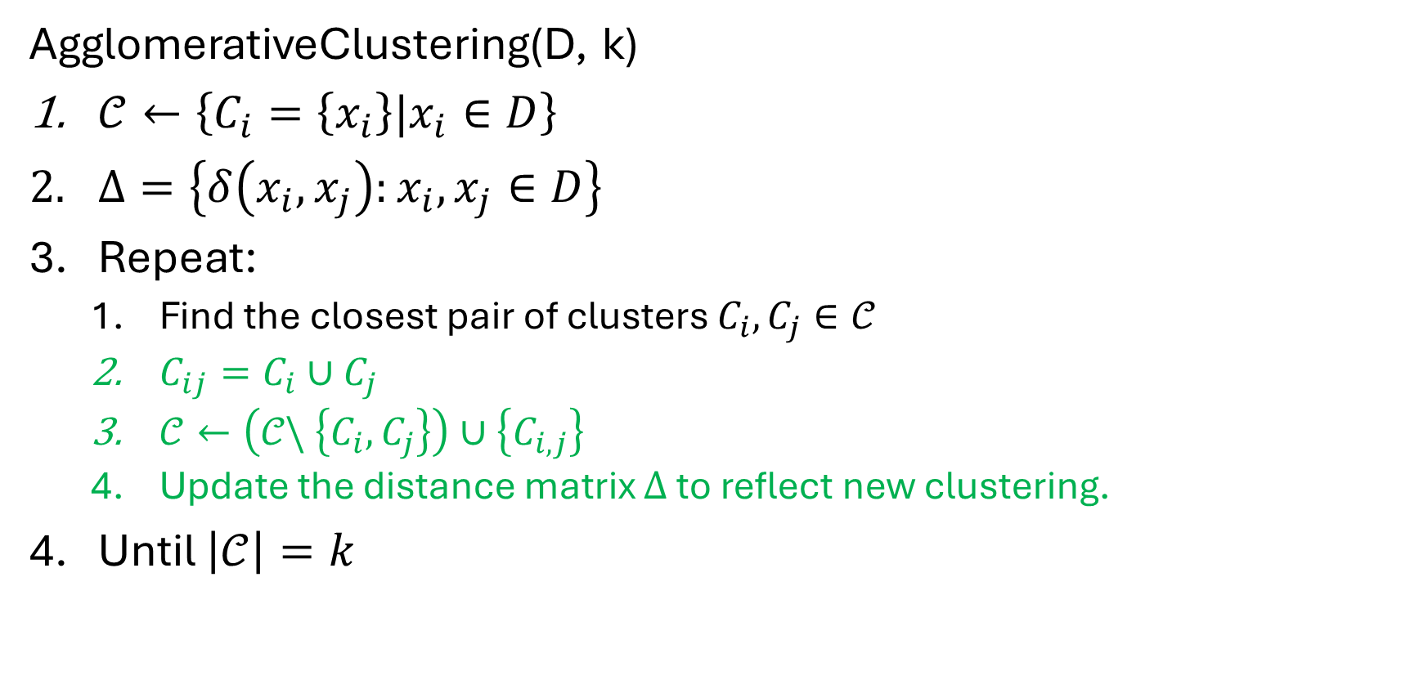
Agglomerative clustering algorithm
AgglomerativeClustering(D, k)
$𝒞←\left\{C_{i}=\left\{x_{i}\right\}|x_{i}∈D\right\}$
$Δ=\left\{δ\left(x_{i}, x_{j}\right):x_{i}, x_{j}∈D\right\}$
Repeat:
Find the closest pair of clusters $C_{i}, C_{j}∈𝒞$
$C_{ij}=C_{i}∪C_{j}$
$𝒞←\left(𝒞\backslash \left\{C_{i},C_{j}\right\}\right)∪\left\{C_{i,j}\right\}$
Update the distance matrix $Δ$ to reflect new clustering.
Until $\left|𝒞\right|=k$

Slide 25

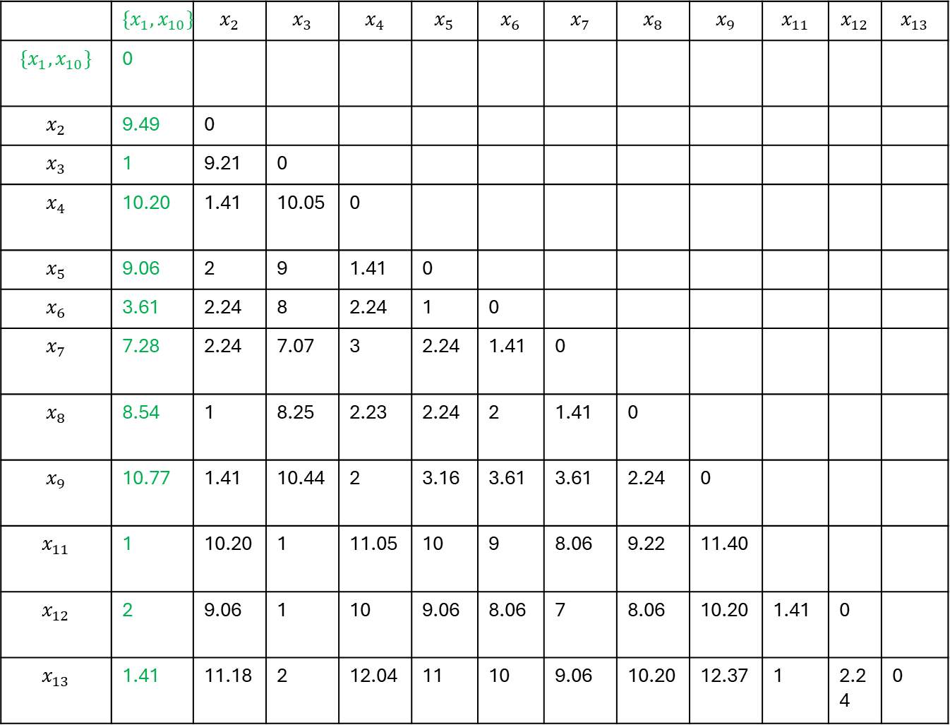
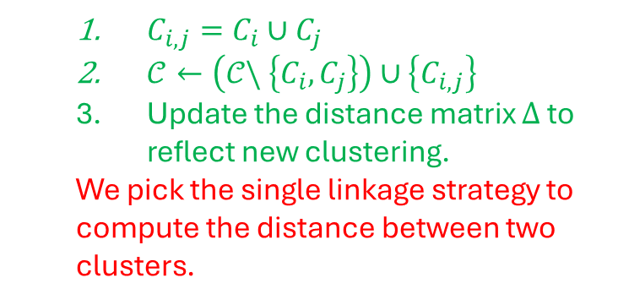
Example
 | $${\{x}_{1}, x_{10}\}$$ | $$x_{2}$$ | $$x_{3}$$ | $$x_{4}$$ | $$x_{5}$$ | $$x_{6}$$ | $$x_{7}$$ | $$x_{8}$$ | $$x_{9}$$ | $$x_{11}$$ | $$x_{12}$$ | $$x_{13}$$
$${\{x}_{1}, x_{10}\}$$ | 0
$$x_{2}$$ | 9.49 | 0
$$x_{3}$$ | 1 | 9.21 | 0
$$x_{4}$$ | 10.20 | 1.41 | 10.05 | 0
$$x_{5}$$ | 9.06 | 2 | 9 | 1.41 | 0
$$x_{6}$$ | 3.61 | 2.24 | 8 | 2.24 | 1 | 0
$$x_{7}$$ | 7.28 | 2.24 | 7.07 | 3 | 2.24 | 1.41 | 0
$$x_{8}$$ | 8.54 | 1 | 8.25 | 2.23 | 2.24 | 2 | 1.41 | 0
$$x_{9}$$ | 10.77 | 1.41 | 10.44 | 2 | 3.16 | 3.61 | 3.61 | 2.24 | 0
$$x_{11}$$ | 1 | 10.20 | 1 | 11.05 | 10 | 9 | 8.06 | 9.22 | 11.40
$$x_{12}$$ | 2 | 9.06 | 1 | 10 | 9.06 | 8.06 | 7 | 8.06 | 10.20 | 1.41 | 0
$$x_{13}$$ | 1.41 | 11.18 | 2 | 12.04 | 11 | 10 | 9.06 | 10.20 | 12.37 | 1 | 2.24 | 0
$$C_{1,10}$$
$C_{i,j}=C_{i}∪C_{j}$
$𝒞←\left(𝒞\backslash \left\{C_{i},C_{j}\right\}\right)∪\left\{C_{i,j}\right\}$
Update the distance matrix $Δ$ to reflect new clustering.
We pick the single linkage strategy to compute the distance between two clusters.

Slide 26

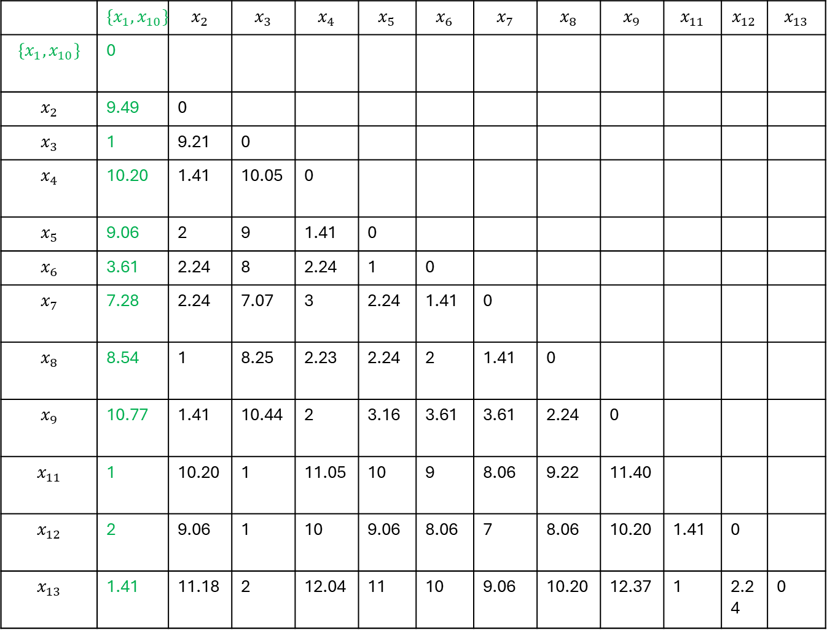
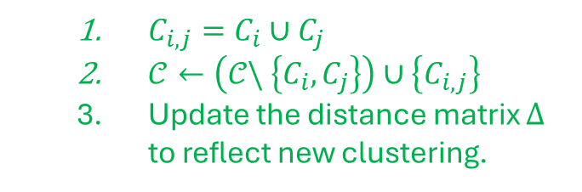
Example
 | $${\{x}_{1}, x_{10}\}$$ | $$x_{2}$$ | $$x_{3}$$ | $$x_{4}$$ | $$x_{5}$$ | $$x_{6}$$ | $$x_{7}$$ | $$x_{8}$$ | $$x_{9}$$ | $$x_{11}$$ | $$x_{12}$$ | $$x_{13}$$
$${\{x}_{1}, x_{10}\}$$ | 0
$$x_{2}$$ | 9.49 | 0
$$x_{3}$$ | 1 | 9.21 | 0
$$x_{4}$$ | 10.20 | 1.41 | 10.05 | 0
$$x_{5}$$ | 9.06 | 2 | 9 | 1.41 | 0
$$x_{6}$$ | 3.61 | 2.24 | 8 | 2.24 | 1 | 0
$$x_{7}$$ | 7.28 | 2.24 | 7.07 | 3 | 2.24 | 1.41 | 0
$$x_{8}$$ | 8.54 | 1 | 8.25 | 2.23 | 2.24 | 2 | 1.41 | 0
$$x_{9}$$ | 10.77 | 1.41 | 10.44 | 2 | 3.16 | 3.61 | 3.61 | 2.24 | 0
$$x_{11}$$ | 1 | 10.20 | 1 | 11.05 | 10 | 9 | 8.06 | 9.22 | 11.40
$$x_{12}$$ | 2 | 9.06 | 1 | 10 | 9.06 | 8.06 | 7 | 8.06 | 10.20 | 1.41 | 0
$$x_{13}$$ | 1.41 | 11.18 | 2 | 12.04 | 11 | 10 | 9.06 | 10.20 | 12.37 | 1 | 2.24 | 0
$$C_{1,10}$$
$C_{i,j}=C_{i}∪C_{j}$
$𝒞←\left(𝒞\backslash \left\{C_{i},C_{j}\right\}\right)∪\left\{C_{i,j}\right\}$
Update the distance matrix $Δ$ to reflect new clustering.

Slide 27
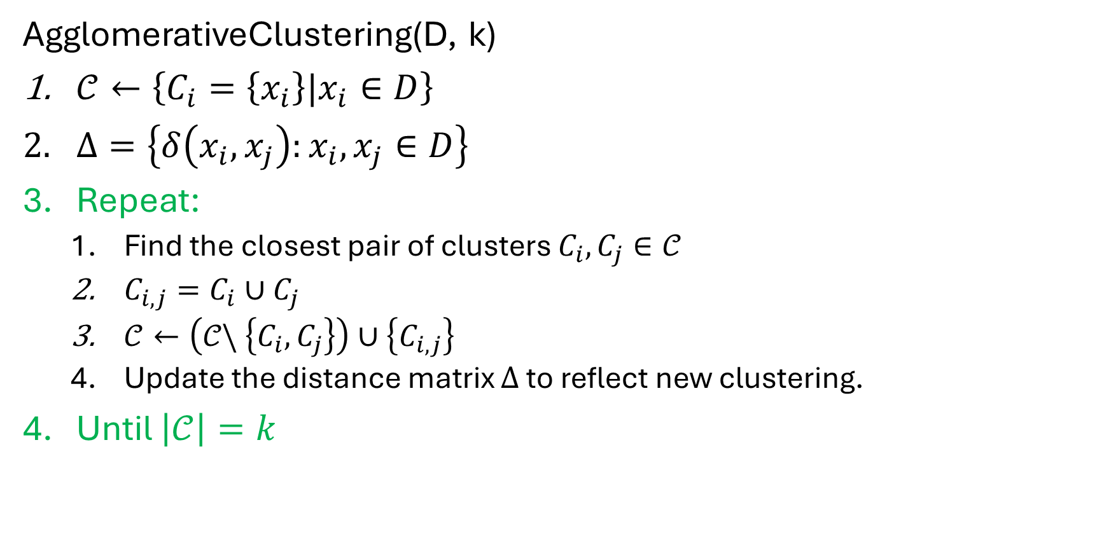
Agglomerative clustering algorithm
AgglomerativeClustering(D, k)
$𝒞←\left\{C_{i}=\left\{x_{i}\right\}|x_{i}∈D\right\}$
$Δ=\left\{δ\left(x_{i}, x_{j}\right):x_{i}, x_{j}∈D\right\}$
Repeat:
Find the closest pair of clusters $C_{i}, C_{j}∈𝒞$
$C_{i,j}=C_{i}∪C_{j}$
$𝒞←\left(𝒞\backslash \left\{C_{i},C_{j}\right\}\right)∪\left\{C_{i,j}\right\}$
Update the distance matrix $Δ$ to reflect new clustering.
Until $\left|𝒞\right|=k$

Slide 28
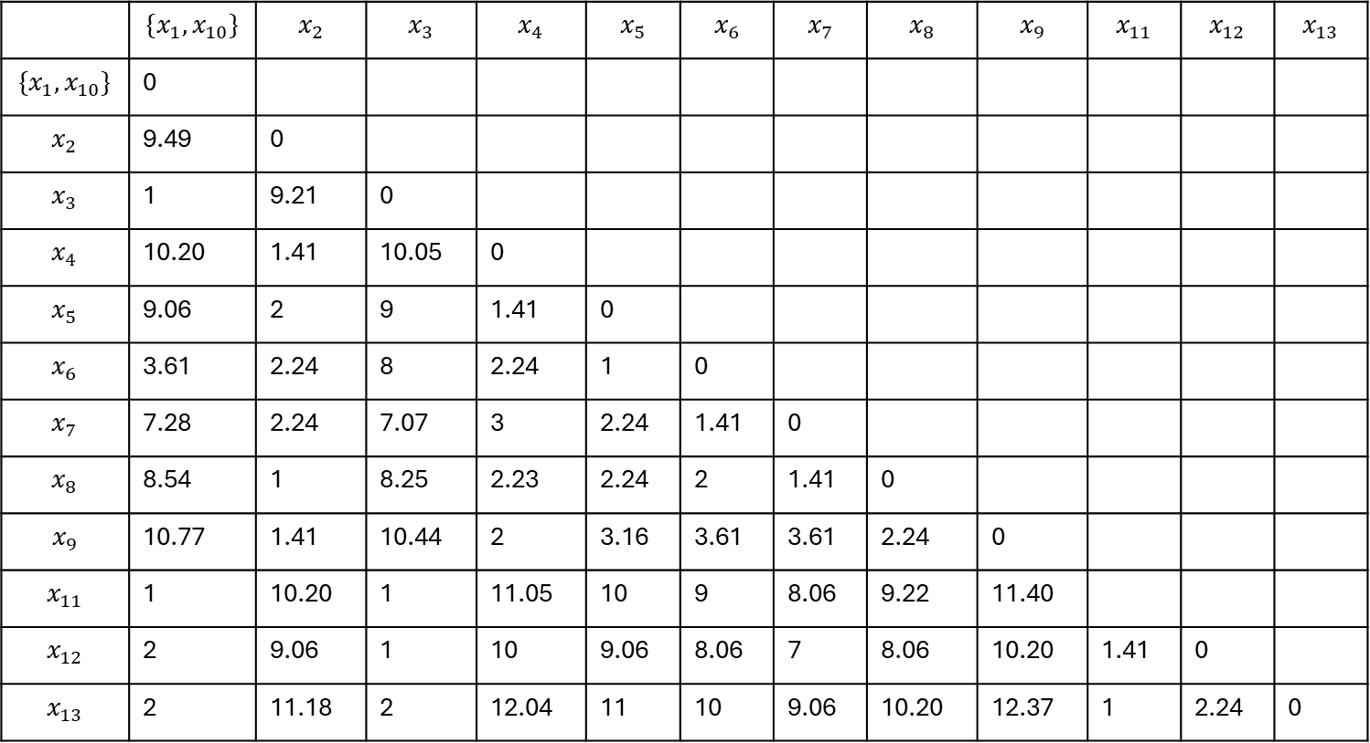
Example
 | $${\{x}_{1}, x_{10}\}$$ | $$x_{2}$$ | $$x_{3}$$ | $$x_{4}$$ | $$x_{5}$$ | $$x_{6}$$ | $$x_{7}$$ | $$x_{8}$$ | $$x_{9}$$ | $$x_{11}$$ | $$x_{12}$$ | $$x_{13}$$
$${\{x}_{1}, x_{10}\}$$ | 0
$$x_{2}$$ | 9.49 | 0
$$x_{3}$$ | 1 | 9.21 | 0
$$x_{4}$$ | 10.20 | 1.41 | 10.05 | 0
$$x_{5}$$ | 9.06 | 2 | 9 | 1.41 | 0
$$x_{6}$$ | 3.61 | 2.24 | 8 | 2.24 | 1 | 0
$$x_{7}$$ | 7.28 | 2.24 | 7.07 | 3 | 2.24 | 1.41 | 0
$$x_{8}$$ | 8.54 | 1 | 8.25 | 2.23 | 2.24 | 2 | 1.41 | 0
$$x_{9}$$ | 10.77 | 1.41 | 10.44 | 2 | 3.16 | 3.61 | 3.61 | 2.24 | 0
$$x_{11}$$ | 1 | 10.20 | 1 | 11.05 | 10 | 9 | 8.06 | 9.22 | 11.40
$$x_{12}$$ | 2 | 9.06 | 1 | 10 | 9.06 | 8.06 | 7 | 8.06 | 10.20 | 1.41 | 0
$$x_{13}$$ | 2 | 11.18 | 2 | 12.04 | 11 | 10 | 9.06 | 10.20 | 12.37 | 1 | 2.24 | 0

Slide 29
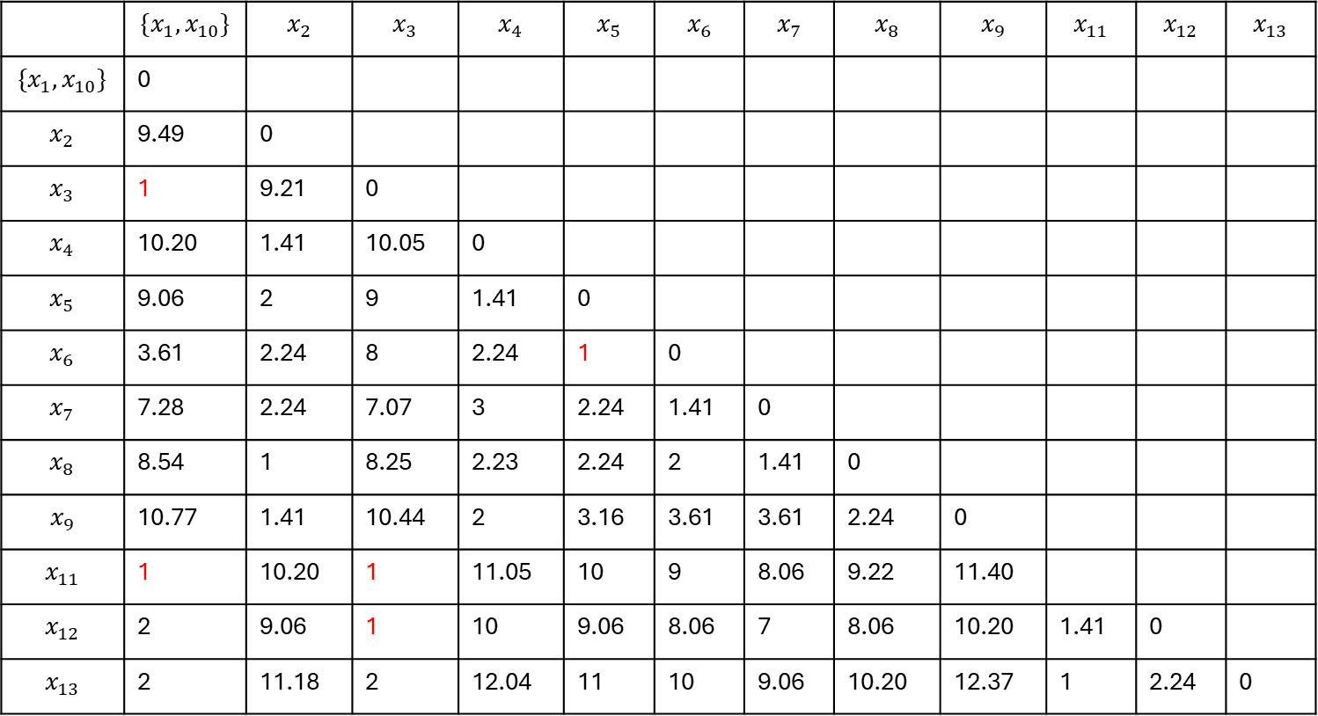
Example
 | $${\{x}_{1}, x_{10}\}$$ | $$x_{2}$$ | $$x_{3}$$ | $$x_{4}$$ | $$x_{5}$$ | $$x_{6}$$ | $$x_{7}$$ | $$x_{8}$$ | $$x_{9}$$ | $$x_{11}$$ | $$x_{12}$$ | $$x_{13}$$
$${\{x}_{1}, x_{10}\}$$ | 0
$$x_{2}$$ | 9.49 | 0
$$x_{3}$$ | 1 | 9.21 | 0
$$x_{4}$$ | 10.20 | 1.41 | 10.05 | 0
$$x_{5}$$ | 9.06 | 2 | 9 | 1.41 | 0
$$x_{6}$$ | 3.61 | 2.24 | 8 | 2.24 | 1 | 0
$$x_{7}$$ | 7.28 | 2.24 | 7.07 | 3 | 2.24 | 1.41 | 0
$$x_{8}$$ | 8.54 | 1 | 8.25 | 2.23 | 2.24 | 2 | 1.41 | 0
$$x_{9}$$ | 10.77 | 1.41 | 10.44 | 2 | 3.16 | 3.61 | 3.61 | 2.24 | 0
$$x_{11}$$ | 1 | 10.20 | 1 | 11.05 | 10 | 9 | 8.06 | 9.22 | 11.40
$$x_{12}$$ | 2 | 9.06 | 1 | 10 | 9.06 | 8.06 | 7 | 8.06 | 10.20 | 1.41 | 0
$$x_{13}$$ | 2 | 11.18 | 2 | 12.04 | 11 | 10 | 9.06 | 10.20 | 12.37 | 1 | 2.24 | 0

Slide 30
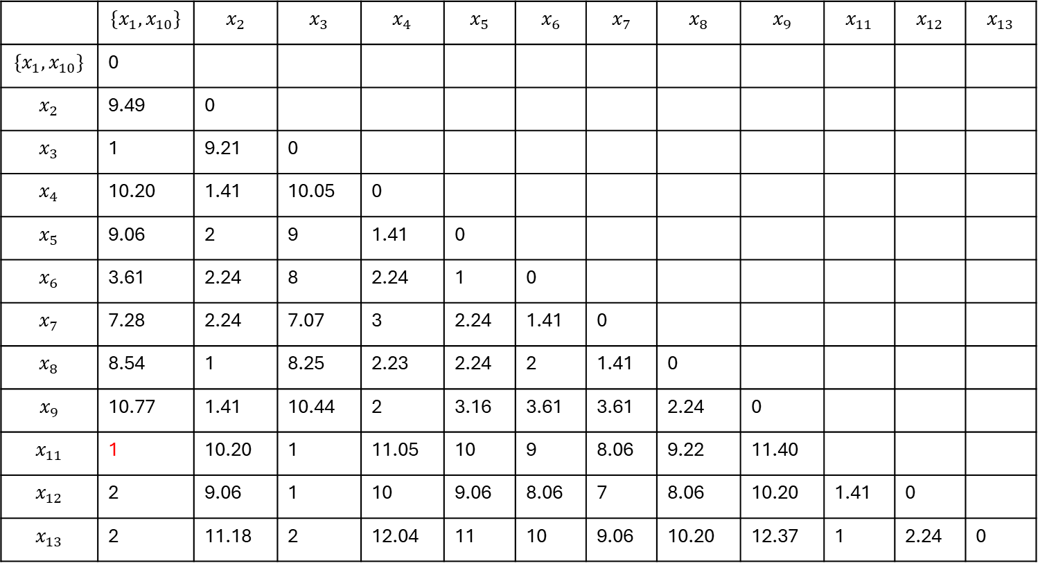
Example
 | $${\{x}_{1}, x_{10}\}$$ | $$x_{2}$$ | $$x_{3}$$ | $$x_{4}$$ | $$x_{5}$$ | $$x_{6}$$ | $$x_{7}$$ | $$x_{8}$$ | $$x_{9}$$ | $$x_{11}$$ | $$x_{12}$$ | $$x_{13}$$
$${\{x}_{1}, x_{10}\}$$ | 0
$$x_{2}$$ | 9.49 | 0
$$x_{3}$$ | 1 | 9.21 | 0
$$x_{4}$$ | 10.20 | 1.41 | 10.05 | 0
$$x_{5}$$ | 9.06 | 2 | 9 | 1.41 | 0
$$x_{6}$$ | 3.61 | 2.24 | 8 | 2.24 | 1 | 0
$$x_{7}$$ | 7.28 | 2.24 | 7.07 | 3 | 2.24 | 1.41 | 0
$$x_{8}$$ | 8.54 | 1 | 8.25 | 2.23 | 2.24 | 2 | 1.41 | 0
$$x_{9}$$ | 10.77 | 1.41 | 10.44 | 2 | 3.16 | 3.61 | 3.61 | 2.24 | 0
$$x_{11}$$ | 1 | 10.20 | 1 | 11.05 | 10 | 9 | 8.06 | 9.22 | 11.40
$$x_{12}$$ | 2 | 9.06 | 1 | 10 | 9.06 | 8.06 | 7 | 8.06 | 10.20 | 1.41 | 0
$$x_{13}$$ | 2 | 11.18 | 2 | 12.04 | 11 | 10 | 9.06 | 10.20 | 12.37 | 1 | 2.24 | 0

Slide 31
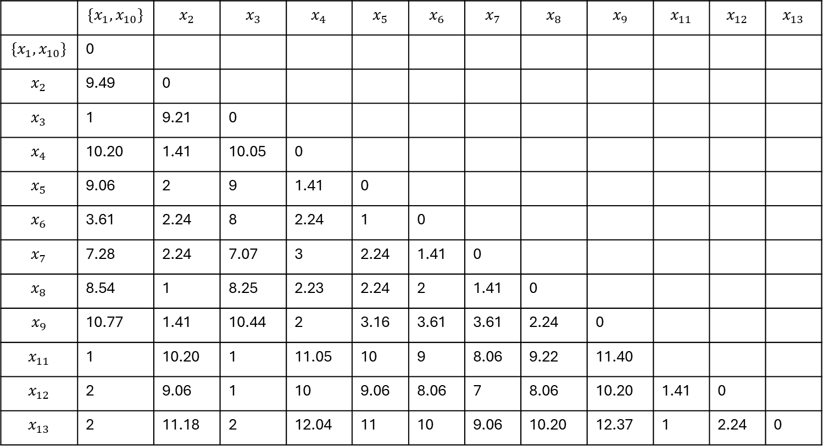

Example
 | $${\{x}_{1}, x_{10}\}$$ | $$x_{2}$$ | $$x_{3}$$ | $$x_{4}$$ | $$x_{5}$$ | $$x_{6}$$ | $$x_{7}$$ | $$x_{8}$$ | $$x_{9}$$ | $$x_{11}$$ | $$x_{12}$$ | $$x_{13}$$
$${\{x}_{1}, x_{10}\}$$ | 0
$$x_{2}$$ | 9.49 | 0
$$x_{3}$$ | 1 | 9.21 | 0
$$x_{4}$$ | 10.20 | 1.41 | 10.05 | 0
$$x_{5}$$ | 9.06 | 2 | 9 | 1.41 | 0
$$x_{6}$$ | 3.61 | 2.24 | 8 | 2.24 | 1 | 0
$$x_{7}$$ | 7.28 | 2.24 | 7.07 | 3 | 2.24 | 1.41 | 0
$$x_{8}$$ | 8.54 | 1 | 8.25 | 2.23 | 2.24 | 2 | 1.41 | 0
$$x_{9}$$ | 10.77 | 1.41 | 10.44 | 2 | 3.16 | 3.61 | 3.61 | 2.24 | 0
$$x_{11}$$ | 1 | 10.20 | 1 | 11.05 | 10 | 9 | 8.06 | 9.22 | 11.40
$$x_{12}$$ | 2 | 9.06 | 1 | 10 | 9.06 | 8.06 | 7 | 8.06 | 10.20 | 1.41 | 0
$$x_{13}$$ | 2 | 11.18 | 2 | 12.04 | 11 | 10 | 9.06 | 10.20 | 12.37 | 1 | 2.24 | 0

Slide 32
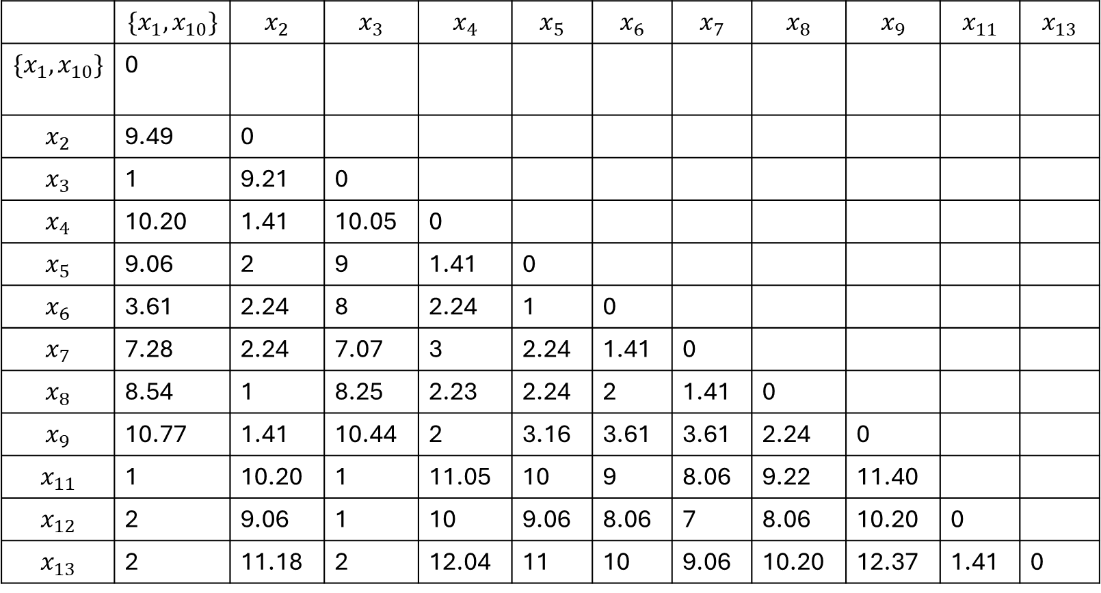

Example
 | $$X_{1}$$ | $$X_{2}$$
$$x_{1}$$ | 3 | 2
$$x_{2}$$ | 13 | 5
$$x_{3}$$ | 4 | 3
$$x_{4}$$ | 14 | 4
$$x_{5}$$ | 13 | 3
$$x_{6}$$ | 12 | 3
$$x_{7}$$ | 11 | 4
$$x_{8}$$ | 12 | 5
$$x_{9}$$ | 14 | 6
$$x_{10}$$ | 4 | 2
$$x_{11}$$ | 3 | 3
$$x_{12}$$ | 4 | 4
$$x_{13}$$ | 2 | 3
 | $${\{x}_{1}, x_{10}\}$$ | $$x_{2}$$ | $$x_{3}$$ | $$x_{4}$$ | $$x_{5}$$ | $$x_{6}$$ | $$x_{7}$$ | $$x_{8}$$ | $$x_{9}$$ | $$x_{11}$$ | $$x_{13}$$
$${\{x}_{1}, x_{10}\}$$ | 0
$$x_{2}$$ | 9.49 | 0
$$x_{3}$$ | 1 | 9.21 | 0
$$x_{4}$$ | 10.20 | 1.41 | 10.05 | 0
$$x_{5}$$ | 9.06 | 2 | 9 | 1.41 | 0
$$x_{6}$$ | 3.61 | 2.24 | 8 | 2.24 | 1 | 0
$$x_{7}$$ | 7.28 | 2.24 | 7.07 | 3 | 2.24 | 1.41 | 0
$$x_{8}$$ | 8.54 | 1 | 8.25 | 2.23 | 2.24 | 2 | 1.41 | 0
$$x_{9}$$ | 10.77 | 1.41 | 10.44 | 2 | 3.16 | 3.61 | 3.61 | 2.24 | 0
$$x_{11}$$ | 1 | 10.20 | 1 | 11.05 | 10 | 9 | 8.06 | 9.22 | 11.40
$$x_{12}$$ | 2 | 9.06 | 1 | 10 | 9.06 | 8.06 | 7 | 8.06 | 10.20 | 0
$$x_{13}$$ | 2 | 11.18 | 2 | 12.04 | 11 | 10 | 9.06 | 10.20 | 12.37 | 1.41 | 0

Slide 33
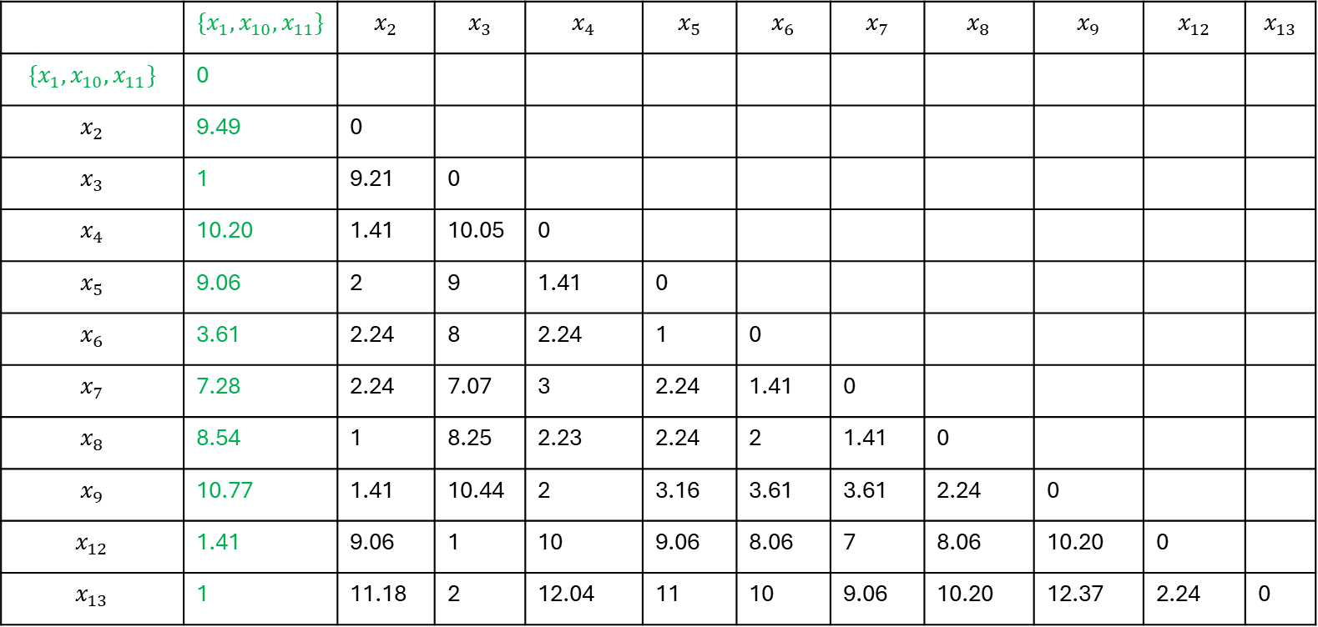

Example
 | $${\{x}_{1}, x_{10}, x_{11}\}$$ | $$x_{2}$$ | $$x_{3}$$ | $$x_{4}$$ | $$x_{5}$$ | $$x_{6}$$ | $$x_{7}$$ | $$x_{8}$$ | $$x_{9}$$ | $$x_{12}$$ | $$x_{13}$$
$${\{x}_{1}, x_{10}, x_{11}\}$$ | 0
$$x_{2}$$ | 9.49 | 0
$$x_{3}$$ | 1 | 9.21 | 0
$$x_{4}$$ | 10.20 | 1.41 | 10.05 | 0
$$x_{5}$$ | 9.06 | 2 | 9 | 1.41 | 0
$$x_{6}$$ | 3.61 | 2.24 | 8 | 2.24 | 1 | 0
$$x_{7}$$ | 7.28 | 2.24 | 7.07 | 3 | 2.24 | 1.41 | 0
$$x_{8}$$ | 8.54 | 1 | 8.25 | 2.23 | 2.24 | 2 | 1.41 | 0
$$x_{9}$$ | 10.77 | 1.41 | 10.44 | 2 | 3.16 | 3.61 | 3.61 | 2.24 | 0
$$x_{12}$$ | 1.41 | 9.06 | 1 | 10 | 9.06 | 8.06 | 7 | 8.06 | 10.20 | 0
$$x_{13}$$ | 1 | 11.18 | 2 | 12.04 | 11 | 10 | 9.06 | 10.20 | 12.37 | 2.24 | 0

Slide 34
Different distance measures will affect results
Linkage | Description
Complete | Maximal inter-cluster dissimilarity. Compute all pairwise dissimilarities between the observations in cluster A and the observations in cluster B, and record the largest of these similarities
Single | Minimal inter-cluster dissimilarity. Compute all pairwise dissimilarities between the observations in cluster A and the observations in cluster B and record the smallest of these dissimilarities.
Average | Mean inter-cluster dissimilarity. Compute all pairwise dissimilarities between the observations in cluster A and the observations in cluster B and record the average of these dissimilarities.
Centroid | Dissimilarity between the centroid for cluster A (a mean vector of length p) and the centroid for cluster B. Centroid linkage can result in undesirable inversions.

Slide 35
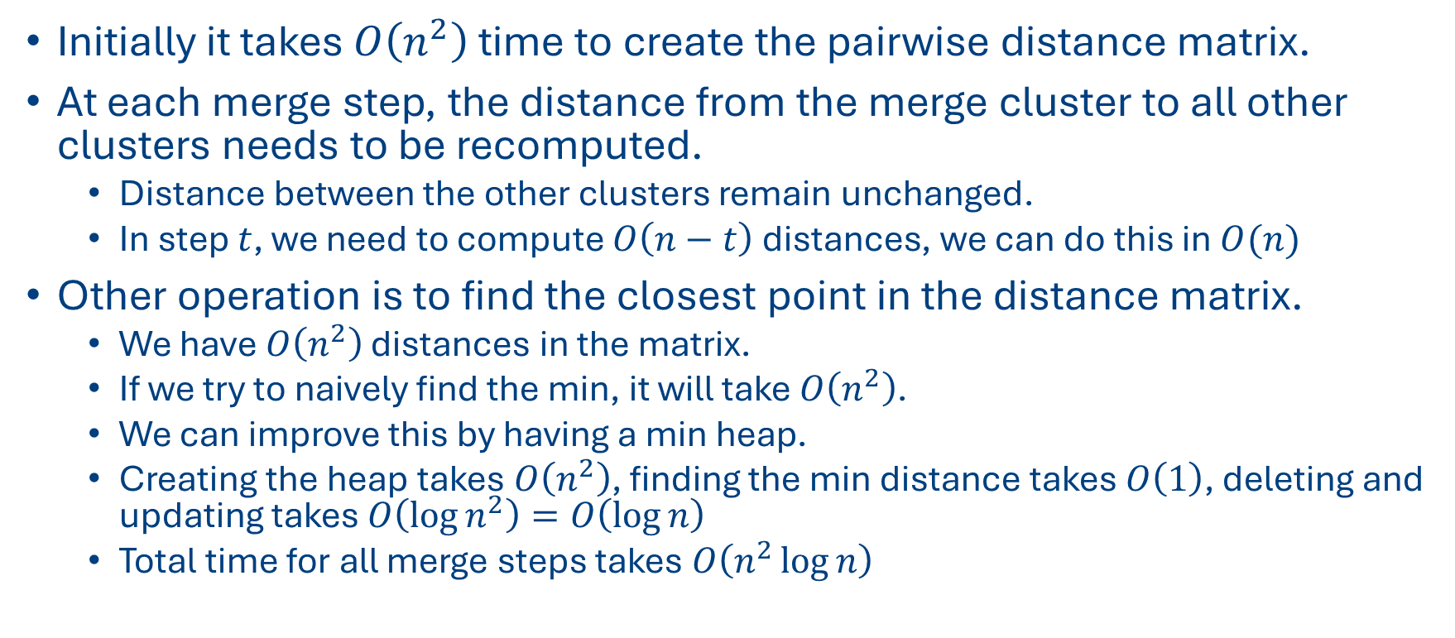
Computation complexity of agglomerative clustering
Initially it takes $O\left(n^{2}\right)$ time to create the pairwise distance matrix.
At each merge step, the distance from the merge cluster to all other clusters needs to be recomputed.
Distance between the other clusters remain unchanged.
In step $t$, we need to compute $O\left(n−t\right)$ distances, we can do this in $O(n)$
Other operation is to find the closest point in the distance matrix.
We have $O\left(n^{2}\right)$ distances in the matrix.
If we try to naively find the min, it will take $O\left(n^{2}\right)$.
We can improve this by having a min heap.
Creating the heap takes $O\left(n^{2}\right)$, finding the min distance takes $O\left(1\right)$, deleting and updating takes $O\left(\log{n^{2}}\right)=O\left(\log{n}\right)$
Total time for all merge steps takes $O\left(n^{2}\log{n}\right)$

